Slide 1
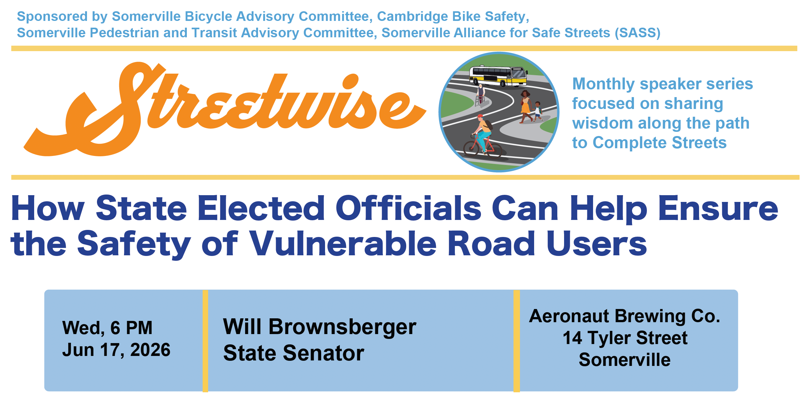
How State Elected Officials Can Help Ensure the Safety

Slide 2
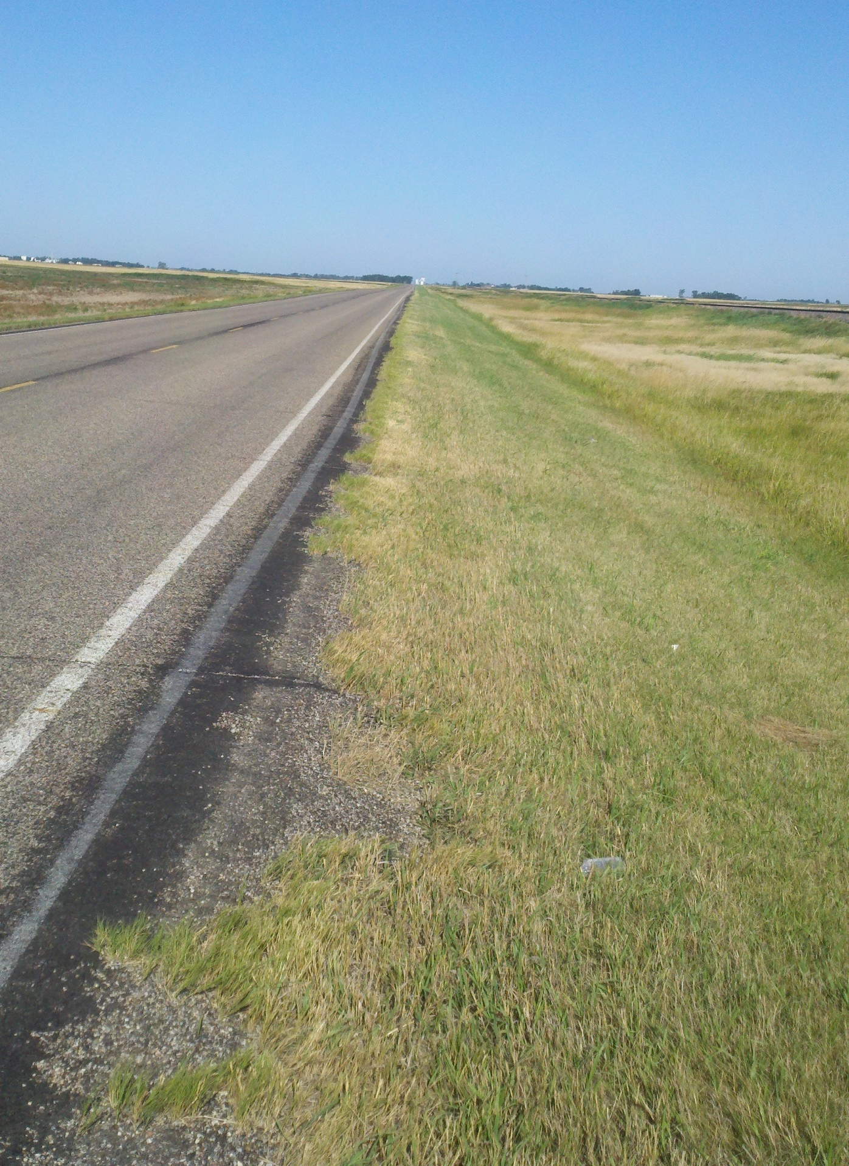
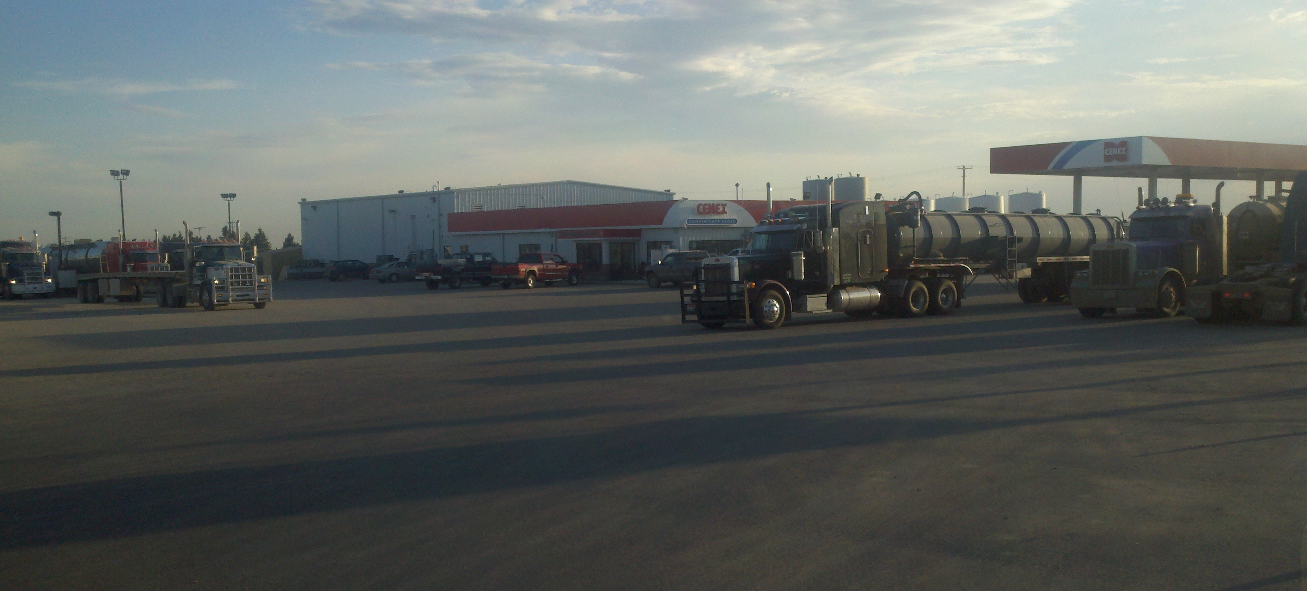
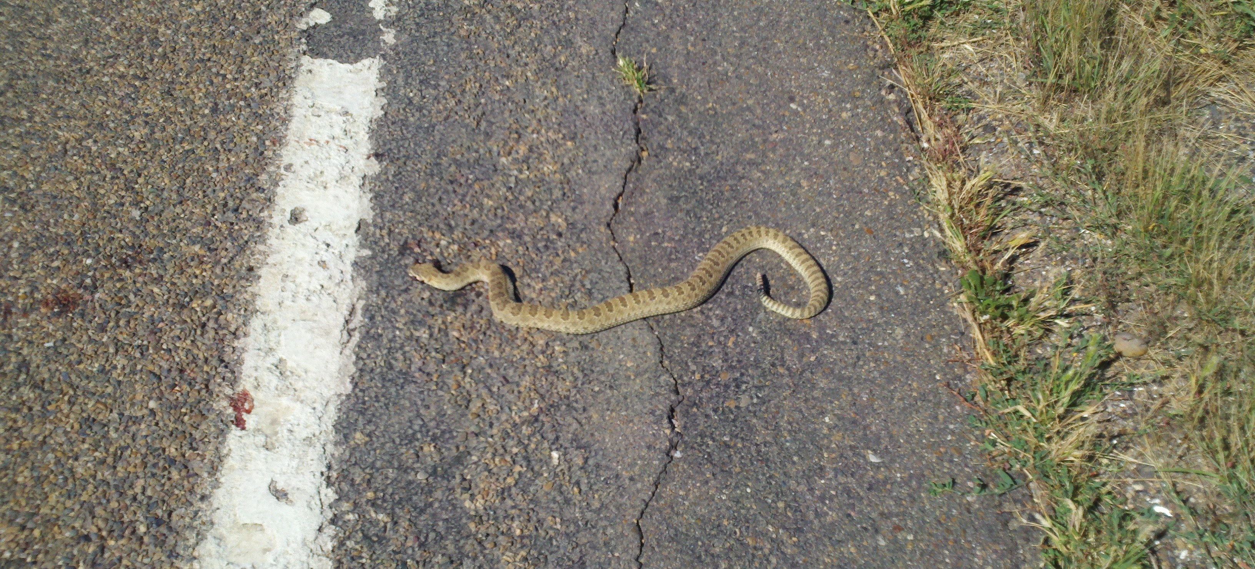

Slide 3
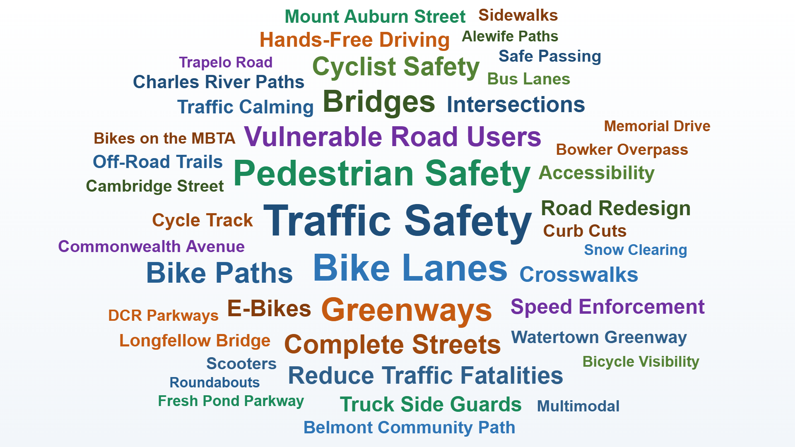

Slide 4
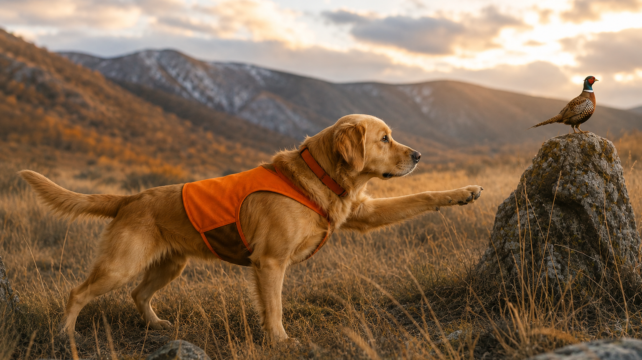

Bird-dogging projects
Showing up in public hearings
Educating staff
Partnering with staff
Securing top-level support
  Legislative
  Executive

Slide 5
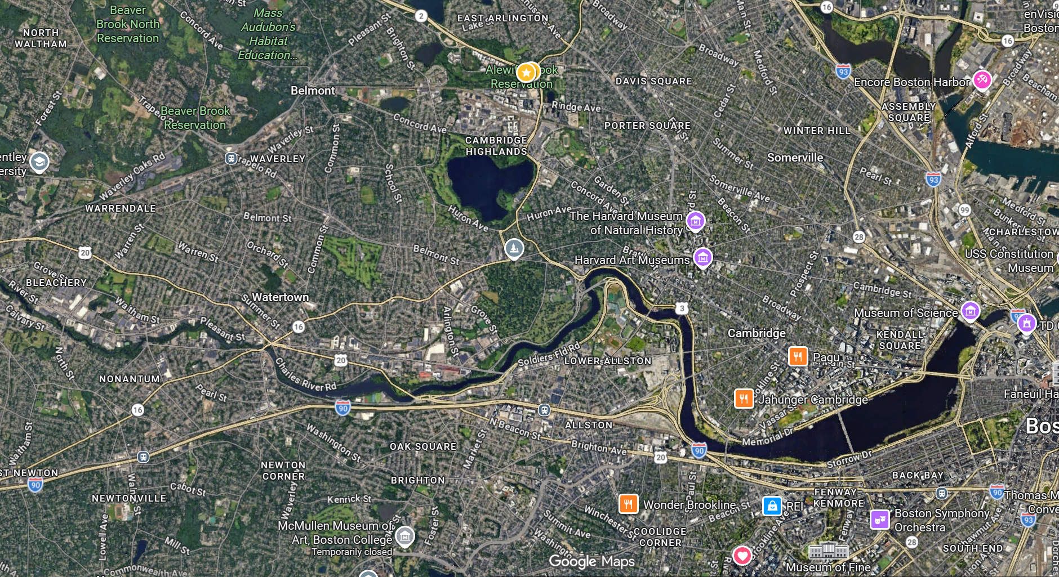















1
2
4
3
5

Slide 6
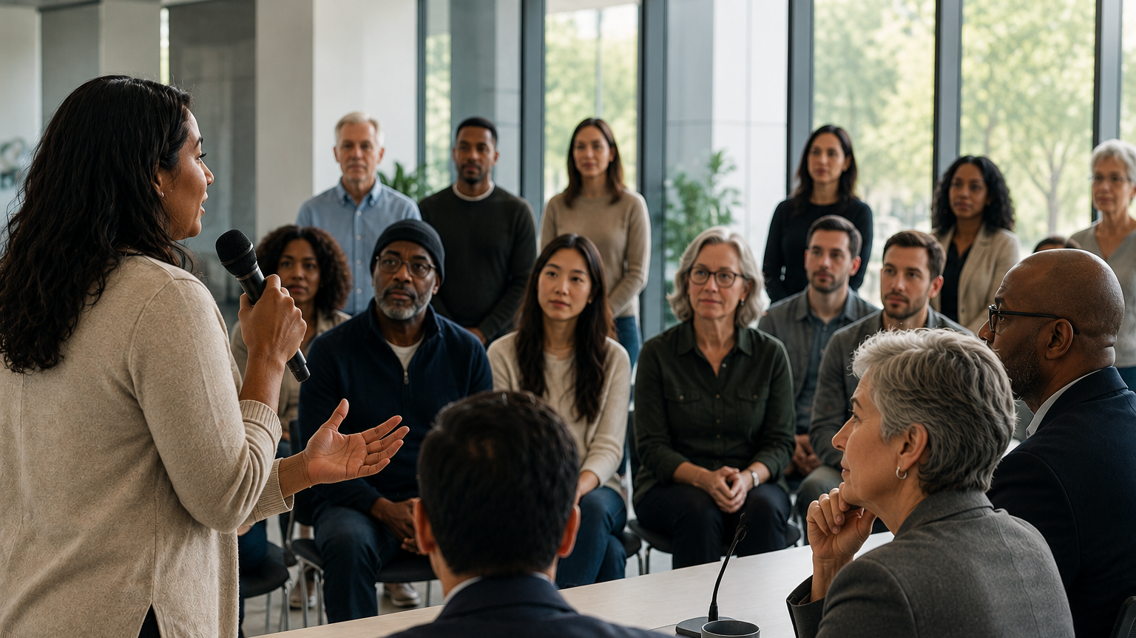
Assuring public input is heard
Question assumptions
Honor community creativity
Elevating neglected projects

Slide 7
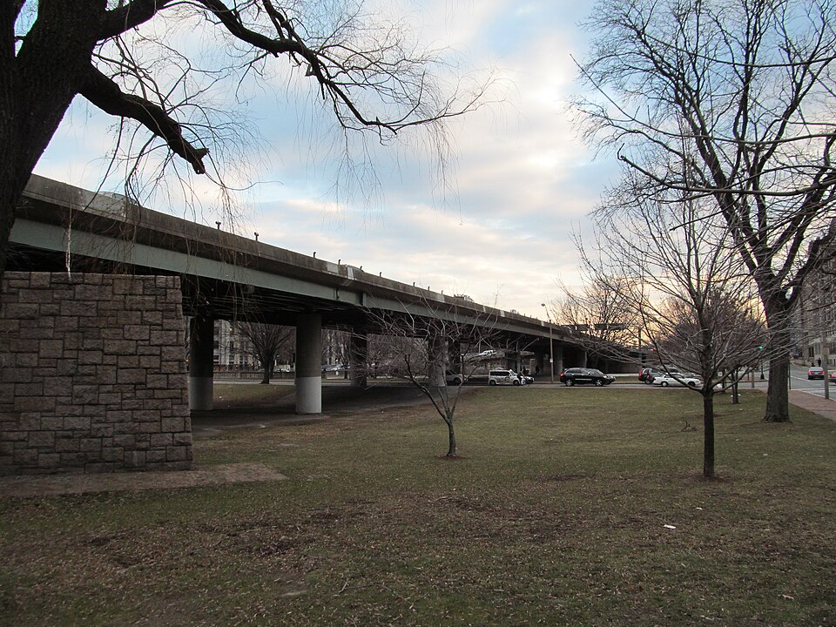
3
1
2

Slide 10
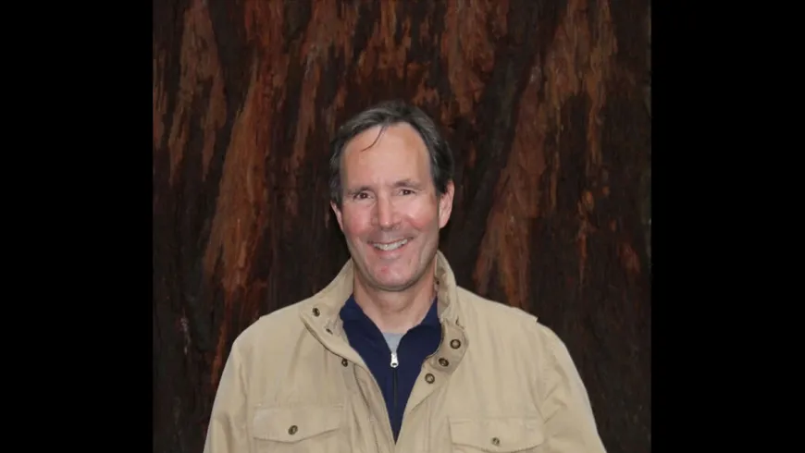

Slide 11
MassDOT
DCR
MassHighway
Connecting agencies
Resolving conflicts
Creating conversations
Watertown
MBTA
Cambridge
BTD
BPDA

Slide 12
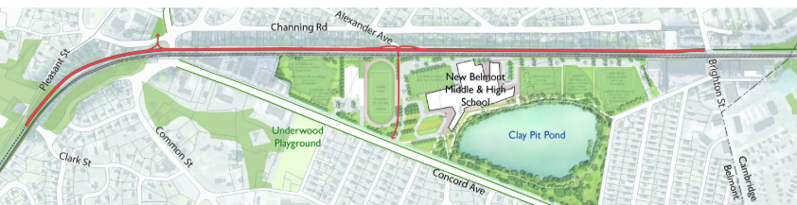
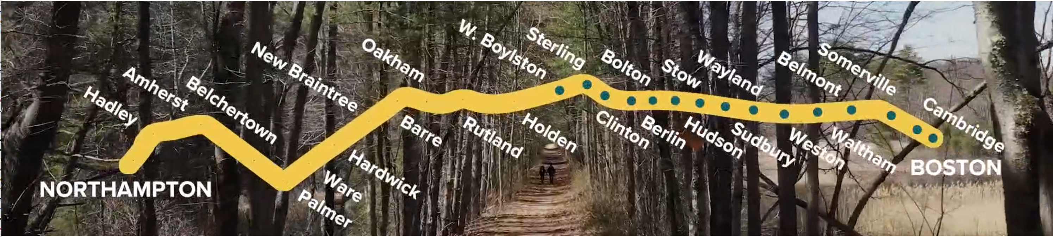
Making Connections – Across Belmont and Across the State
BelmontCommunityPath.Com
MassachusettsCentralRailTrail.Org

Slide 13
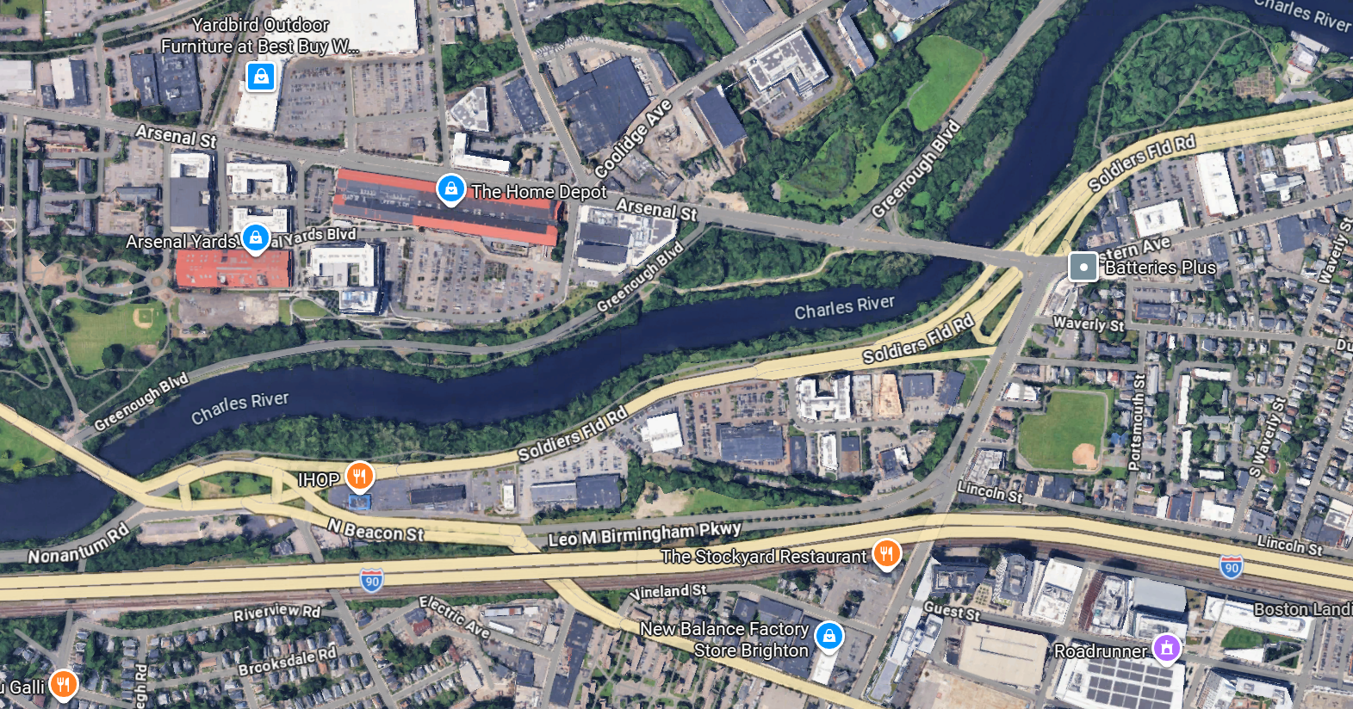

-

Slide 14
Building Safety Infrastructure
Bird-dogging projects
Assuring public input is heard
Connecting agencies
. . . always with respect for agency good faith.

Slide 15
Legislation
Rules of the Road 2008
2013 Advocacy Agenda
  Cell phone ban message
  Automated enforcement
  Vulnerable road user protections
    Rules of the road (2022)
    Truck safety
. . . finite degree of behavior change due to legislation
Rules of the Road 2026-7? Micromobility

Slide 16
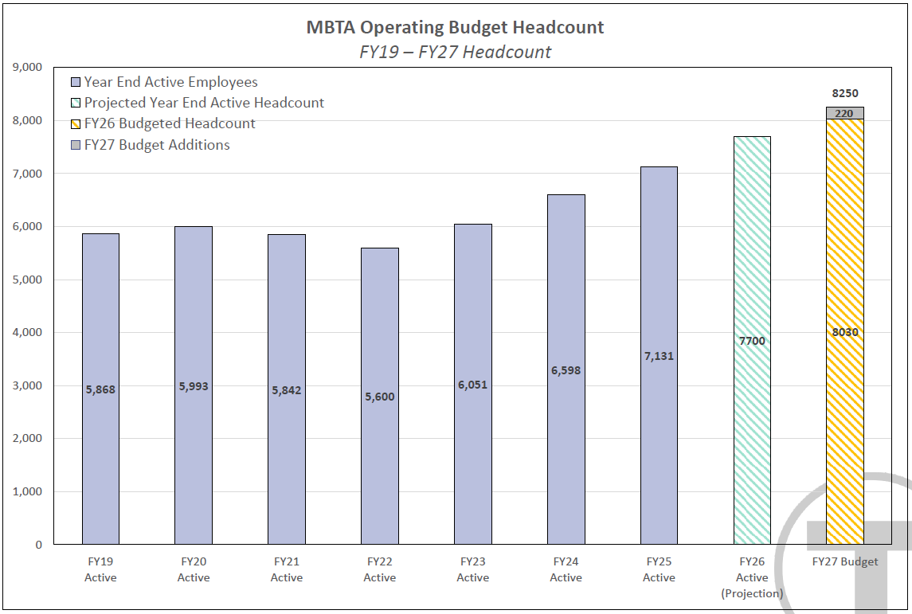
https://www.mbta.com/events/2026-05-28/board-meeting-mbta-board-directors-hybrid-0

Slide 17
Partner
Serve as trusted partner to agencies and advocates in making local safety projects happen
Bird-dogging projects
Assuring public input is heard
Connecting agencies
Legislate
Legislate for safety – subject to practical limits of legislative behavior change
Fund
Fund transportation, especially public transportation -- local projects subject to local bandwidth and political will

