Slide 1
Watertown Aid Overview
April 14, 2026 State Senator Will Brownsberger
william.brownsberger@masenate.gov 617-771-8274 (cell)
willbrownsberger.com

Slide 2
State education aid is roughly based on need and ability to pay.
"Foundation" budget is amount of resources needed to run basic school system for specific student population
Required local contribution reflects ability to pay computed from property value and income in the municipality
Aid is primarily based on foundation budget less required local contribution

Slide 3
For 10 years before 2014, Watertown was underfunded as compared to communities with similar ability to pay*
Received only 13% of foundation budget (vs. 17.5% target)
Investigation revealed that underfunding was due to formula glitches (not deliberate policy)
Watertown was not alone; built support for fix among similarly mistreated communities
Formula fix raised Watertown aid share of budget from 13% to 17.5% by FY2019, now 19%.
* Background at: https://willbrownsberger.com/whats-wrong-with-chapter-70/

Slide 4
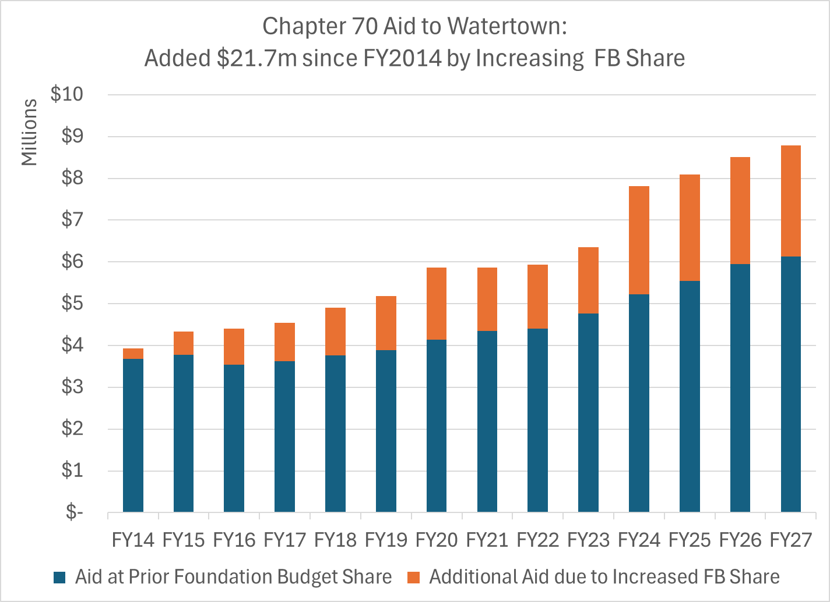
$21.7 Million Additional Aid due to increased share*
* Bars are annual Chapter 70 Education Aid. Orange segment is portion of aid due to increased share: Computed in each year as difference between (a) actual aid and (b) aid at uncorrected share level. Aid at uncorrected share level computed as 13.1% (prior ten-year actual average of ratio of aid to foundation budget) multiplied by applicable foundation budget. Computation details at https://willbrownsberger.com/download-education-aid-files/

Slide 5
Other State Education Aid Increases
Statewide effort to increase Foundation Budget based on higher allowances for health care, special education, etc.
Fully funded special education circuit breaker every year since 2019 -- $3.4m to Watertown in FY25
Special “pothole” account as device to support Watertown (based on high special ed spending through Perkins): $125k to 250k per year
Additional 2026 earmark funding for special education ($150K in current supp. budget)

Slide 6
MBTA Improvements
71/73 Bus Acceleration
Most crowded bus lines in the system by occupancy ratio
Initiated redesign of Fresh Pond Parkway/ Mount Auburn Intersection
Bus lane solution substantially improves bus throughput
Battery buses shortly to arrive will reinstate dedicated service quality
Regional Rail improvements – Waverley and Boston Landing (results very limited so far; interrupted by COVID and MBTA core service focus)

Slide 7
Major DCR Projects
Done: Cambridge-Watertown Greenway – $250,000 drainage funding* and continuing agency advocacy and follow-up
Done: Road, sidewalk, and river path improvements from Watertown Square to Yacht Club – $500,000 private funding** and continuing advocacy and follow-up
In Progress: Earmarks and continuing advocacy for Arsenal Street and North Beacon Street bridges/intersections
Early conceptual: Charles River sea wall elevation to address increasing risk of storm surge due to sea level rise
Early conceptual: Passive recreation plan for sealed hazardous waste site on former GSA property
* An Act Relative to Immediate COVID Recovery Needs, Senate 2564 #348, Chapter 102 of the Acts of 2021;
** From Simmons College -- Daly Field community benefits, Chapter 223 of 2012

Slide 8
Support for Watertown Square
2024: $10 Million Bond Bill Earmark for infrastructure and other public improvements
2025: $750,000 Supplemental Budget Earmark for transportation improvements in Watertown Square
2026: $250,000 Supplemental Budget Earmark for design expenses related to the main intersection in Watertown Square
Notes: Senate 2856, #17, Chapter 238 of Acts of 2024; S2512, #21, Chapter 7 of the Acts of 2025; Senate approved earmark: S3041 (2026) #209

Slide 9
Other local project support
2016: $200,000 for Arsenal Street Corridor improvements
2016: $300,000 for business area façade improvements
2021: $150,000 for lead pipe replacement and awareness
2022: $900,000 for Saltonstall Park Improvements
2022: $500,000 for North Branch Library (Bond Bill Earmark)
2024: $500,000 for Group Housing (Bond Bill Earmark)
Economic Devevelopment Appropriation, Senate 2423 #140, Chapter 219 of Acts of 2016;
An Act Relative to Immediate COVID Recovery Needs, Senate 2564 #348, Chapter 102 of the Acts of 2021;
Economic Devevelopment Appropriation, Senate 3018, #234, Chapter 268 of 2022;
General Government Bond Bill, Senate 2951, #129, Chapter 140 of Acts of 2022.
Housing Bond Bill, Senate 2834, #21, Chapter 150 of Acts of 2024 (Nichols Ave Group Home)

Slide 10
Other Earmarks Approved in Senate Version of FY26 Supplemental Budget
$100,000 for after school transportation
$200,000 for local shuttle bus transportation
$150,000 for extraordinary special education costs
Amendment numbers 209, 215, 216 to Senate Version of 2026 Supplemental Budget (S3041)

Slide 11
Home Rule Petitions
2012 | Ch. 41 | Special police officer appointments |
2012 | Ch. 327 | Menton Corner intersection designation |
2015 | Ch. 111 | Increased residential property tax exemption |
2016 | Ch. 73 | 15 additional on-premises liquor licenses (1st round) |
2017 | Ch. 32 | Firefighter Toscano funeral expenses |
2020 | Ch. 48 | 15 additional on-premises liquor licenses (2nd round) |
2022 | Ch. 220 | Authority to acquire property in Waltham |
2022 | Ch. 302 | Affordable housing linkage fee |
2023 | Ch. 5 | Updated special police officer authority |
2023 | Ch. 58 | Property tax classification (50% residential factor, FY2024–26) |
2024 | Ch. 189 | Municipal charges lien authority |
2025 | Ch. 60 | Parker School site (124 Watertown St.) lease authority |
2026 FULL SUPPORT FOR PENDING TAX CLASSIFICATION BILL

Slide 12
Thank you!
State Senator Will Brownsberger william.brownsberger@masenate.gov 617-771-8274 (cell)

