Slide 1
Utility Rates 101
March 4, 2025

Slide 2
Roles and Responsibilities of the DPU
The DPU is a quasi-judicial agency led by a three-person Commission that is responsible for the oversight of investor-owned electric power, natural gas, and water utilities in the Commonwealth.
Its role in regulating gas and electric companies dates back to 1885 with the establishment of the Board of Gas Commissioners.
In addition to its role overseeing electric, gas, and water utilities, the DPU also plays a role in regulating certain transportation matters (e.g., transportation network carriers, moving, towing, and bus companies), rail safety oversight, gas pipeline safety, and the siting and permitting of energy facilities.
In addition to reviewing and approving utility rates, the DPU also exercises a significant role in establishing state policy as it relates to safety, reliability, clean energy and climate, and consumer protection.
The legislature has established the DPU’s responsibilities and priorities in G.L. c. 25 § 1A as follows:
In discharging its responsibilities under this chapter and chapter 164, the department shall, with respect to itself and the entities it regulates, prioritize safety, security, reliability of service, affordability, equity and reductions in greenhouse gas emissions to meet statewide greenhouse gas emission limits and sublimits established pursuant to chapter 21N.

Slide 3
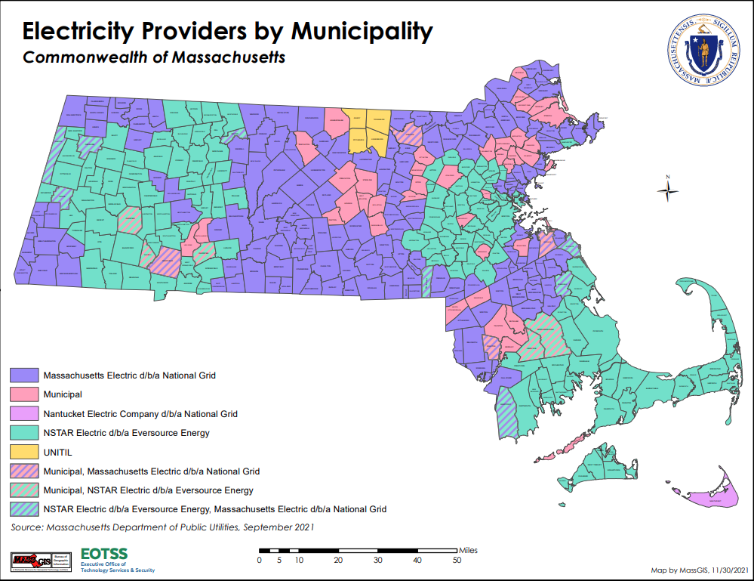
Electric Distribution Companies
There are three investor-owned electric utilities in Massachusetts, which serve all or part of 312 municipalities:
Eversource
National Grid
Unitil
There are also 41 Municipal Light Plants (MLPs), which serve all or part of 48 municipalities.
MLPs serve about 14% of the population and electric load in Massachusetts.
The DPU has more limited jurisdiction over MLPs and does not review or approve their rates.
MLPs are also exempt from most state policies established by the legislature.
This presentation will focus on the DPU’s ratemaking authority over the investor-owned electric utilities.

Slide 4
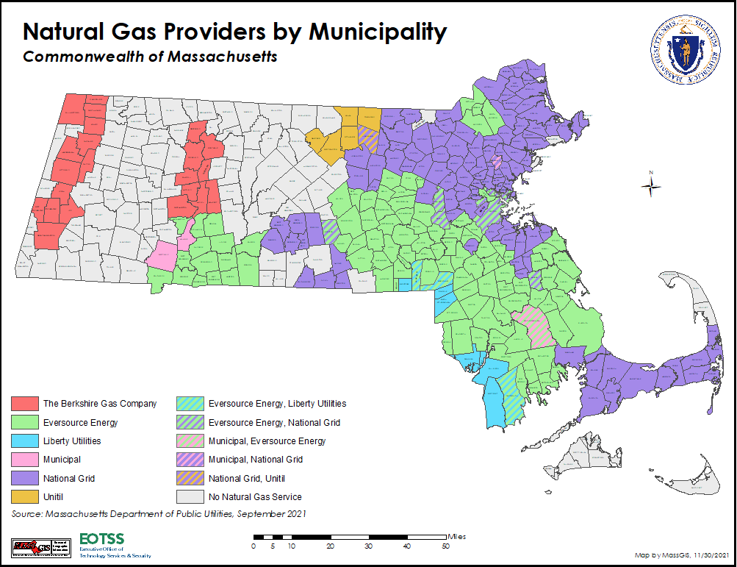
Gas Distribution Companies
There are five investor-owned gas utilities in Massachusetts, which serve customers in parts of 254 municipalities:
Berkshire Gas Company
Eversource
Liberty Utilities
National Grid
Unitil
There are also 4 Municipal Gas Companies, which serve parts of 4 municipalities:
Holyoke
Middleborough
Wakefield
Westfield
Similar to electric MLPs, the DPU has limited jurisdiction over Municipal Gas Companies and does not review or approve their rates.
95 municipalities have no access to gas service.

Slide 5
Adjudicatory Proceedings at the DPU
All DPU proceedings that involve the establishment or change of a rate are adjudicatory proceedings, as that term is defined in G.L. c. 30A § 1.
These are often complex legal proceedings that include many steps, including:
Filing of a petition to increase rates
Issuance of an Order of Notice by the DPU
Filing of petitions to intervene
Issuance of orders on petitions to intervene
One or more public hearings
Submission of testimonial evidence by intervening parties (if requested)
Formal discovery on petitions and evidence
Evidentiary hearings (if requested)
Submission of briefs and reply briefs by intervening parties
Department issuance of one or more orders
Compliance filings (if necessary)
Department approval of compliance filings
Motions for clarification and reconsideration (if necessary)
Ex parte rules apply to these proceedings, which prevent the DPU staff and Commission from discussing substantive matters before them with outside parties.
The Attorney General is generally a party to all rate (and most other DPU) proceedings in her role as Ratepayer Advocate.
Appeals of DPU orders are reviewed directly by the Supreme Judicial Court.

Slide 6
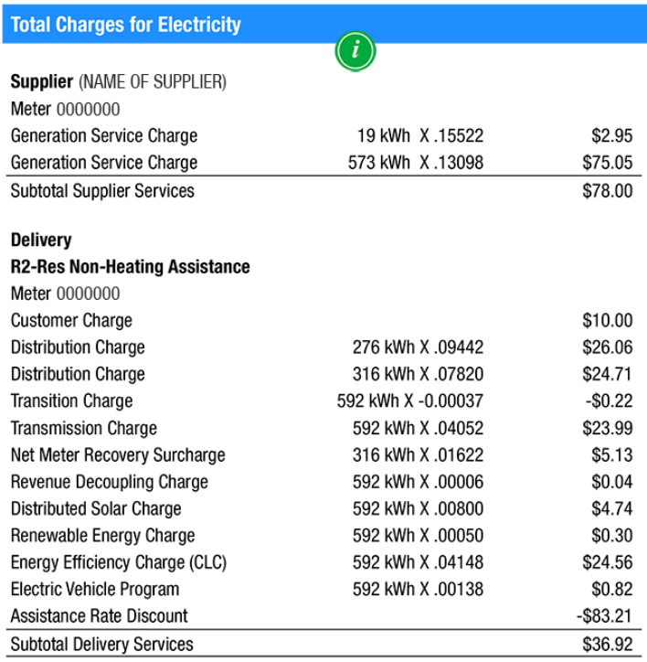
Rate Cases
A rate case is a formal legal proceeding to amend a regulated utility’s rates, which begins with a utility application.
The regulated electric utilities are required to file a rate application every five years
In Massachusetts, regulated electric and gas companies own and operate the distribution systems; thus, rate applications are used to change customer and distribution charges.
Customer and distribution charges make up a portion of the overall delivery costs assessed to customers.
The DPU reviews the costs in the rate application to set the revenue requirement, which is the annual revenue the utility needs to cover its costs and earn a reasonable rate of return. The DPU also sets the utility’s ROE.
Revenue Requirement = [(Rate Base)*(Rate of Return)]+Operating/Other Costs
The revenue requirement is made up of:
Rate base is the total value of a utility’s asset
Rate of return is the weighted average of the utility’s cost of debt and allowed return on equity (ROE) set by the DPU in the rate case
Operating costs, such as employee salaries; not eligible for a return
Other costs include depreciation expense and taxes, among others
The DPU also reviews and approves rate designs for each customer class to ensure equitable sharing of costs and send appropriate customer price signals.
Rate cases include significant testimony, discovery, and stakeholder participation.

Slide 7
Other Ratemaking Proceedings
Rate cases review and set customer and distribution charges. Other electric and gas charges are administratively reviewed and approved through separate, typically individual, adjudicated proceedings.
Supply: The DPU reviews and administratively approves standard service supply rates. Standard service is procured by the electric and gas utilities from wholesale suppliers, who pass on the costs from suppliers. For electric utilities, these rates change every six months for residential customers and every three months for C&I customers. For gas utilities, these rates can change every month.
Reconciling Distribution Charges: These charges are used to recover specific categories of costs of the regulated electric and gas utilities (e.g., major storm response costs) outside of the customer and distribution charges set in rate cases. These charges allow the utilities to recover the actual cost incurred in these categories and are adjusted annually to reflect any over- or under-collection of actual costs from the prior period.
Revenue Decoupling and Annual Distribution Charge Changes: Each year distribution charges are adjusted based on any over- or under-collection against the approved revenue requirement from the prior rate case. This is called revenue decoupling and is intended to review any disincentive to energy efficiency. Additionally, rate cases may allow for an annual adjustment for inflation and other factors in the distribution charge.
Transmission Charges: Regional and local transmission costs are allocated to Massachusetts customers base on federal policies and are passed on to customers through their utility bill. Transmission charges are updated annually actual transmission costs and to adjust for any over- or under-collection in the prior period.
Importantly, underlying transmission and supply costs are outside of the DPU’s jurisdiction.

Slide 8
Base Distribution Rates vs. Reconciling Factors
Base Distribution Rates
Reconciling Factors
Rates are set during a rate case
Rates are set every five years (for electric)
Regulatory review occurs after costs are spent
Includes extensive regulatory review
Cost are currently based on historical test year costs plus PBR formula
EDCs do not recover the exact amount of costs incurred
Large increases in costs between rate cases are not recovered by the EDC
Rates are set outside a rate case
Rates are set every year
Regulatory review typically occurs before costs are spent
Sometimes includes regulatory review
Costs are typically based on forecast of next year’s cost
EDCs recover the exact amount of costs incurred
Large increases in costs between rate cases are recovered by the EDC

Slide 9
Types of Charges Assessed to Customers
There are three primary types of charges that may appear on customer bills:
Fixed Charges – Recurring charges that are usually set at a specific dollar amount per month. For example, utility customer charges in Massachusetts are typically around $10 per month and are designed to recover a portion of a utility’s fixed costs of providing service to customers (e.g., billing, operations, etc.).
Volumetric Charges – Charges that are assessed based on the volume of energy consumed in a particular month. For electric, these are set on a $ per kilowatt hour basis. For gas, they are set on a $ per therm basis. Residential rates in Massachusetts are almost exclusively structured as volumetric charges.
Block or Step Rates - For some customers (mostly commercial), the volumetric rate may vary based on usage (e.g., $0.05/kWh for the first 1,000 kWh and $0.03/kWh for any consumption above that amount).
Demand Charges – Charges that are assessed based on the maximum amount of energy used in a discrete time period. These require an interval meter that measures energy consumption at regular intervals (e.g., every 15 minutes) to determine the highest usage in an interval over the billing period. Residential customers in Massachusetts are not assessed demand charges today, however, commercial customers, particularly larger ones, are. Demand charges for electricity are expressed as a $ per kilowatt-month.
Additionally, customers may be subject to Seasonal or Time of Use Charges, via which a volumetric or demand charge is set at different amounts depending on the time of year and/or time of day. Time of day charges are generally not available for residential customers today but may be once advanced meters are deployed in the coming years.

Slide 10
Current Residential Volumetric Gas Charges – National Grid

Slide 11
Breakdown of Gas Charges

Slide 12
Drivers of Recent Gas Bill Increases
Every November 1st, two of the major components of gas rates are adjusted:
The Gas Adjustment Factor (GAF): The rate charged to customers to purchase and transport gas to Massachusetts.
The Local Distribution Adjustment Factor (LDAF): The rate charged to customers to recover costs related to energy efficiency, environmental response, Attorney General consultants, residential assistance programs, and the Gas System Enhancement Replacement Program (GSEP).
These two charges saw increases proposed by certain utilities for effect this past November 1st, which were approved by the DPU.
The increases to the GAF were significant, but typical of the size of adjustments that are made at the beginning of every winter heating season.
A significant driver of rate increases for certain utilities (particularly Eversource and National Grid), were upward adjustments to their LDAFs. These were primarily driven by increases to energy efficiency budgets but were also significantly impacted by increases in costs from utility GSEP programs, as well as upward adjustments to their residential assistance and revenue decoupling factors.
Additionally, Eversource Gas of Massachusetts (formerly Columbia Gas) customers also experienced an increase to their Distribution Charges.
When customers received their February bills for usage in January, complaints increased significantly.
While higher rates played a significant role in year over year bill increases, higher usage was the biggest driver in customer bill increases, as this January was significantly colder than last January.

Slide 13
DPU and Utility Response to Gas Bill Complaints
Timeline of Events:
Week of February 9th – Gas customers begin to receive January gas bills
February 14th – Over 80 legislators submit a letter to DPU urging action on rates
February 17th – Governor Healey submits a letter to DPU urging immediate bill relief
February 20th – DPU issues letter to gas companies directing them to file proposals that reduce bills for the remainder of the heating season (March and April) by at least 5%
February 24th – Gas companies file proposals to reduce customer bills by 7.4% to 16%
February 28th – DPU issues orders approving company bill reduction proposals and approving the three-year energy efficiency plan with a $500 million budget reduction ($250 million from electric budget, $250 million from gas)
March 1st – New lower rates in effect
Summary of bill reductions:
DPU order on efficiency plans should nearly eliminate the need for companies to defer cost recovery to later this year.

Slide 14
Current Residential Volumetric Electric Charges – National Grid

Slide 15
Breakdown of Electric Charges

Slide 16
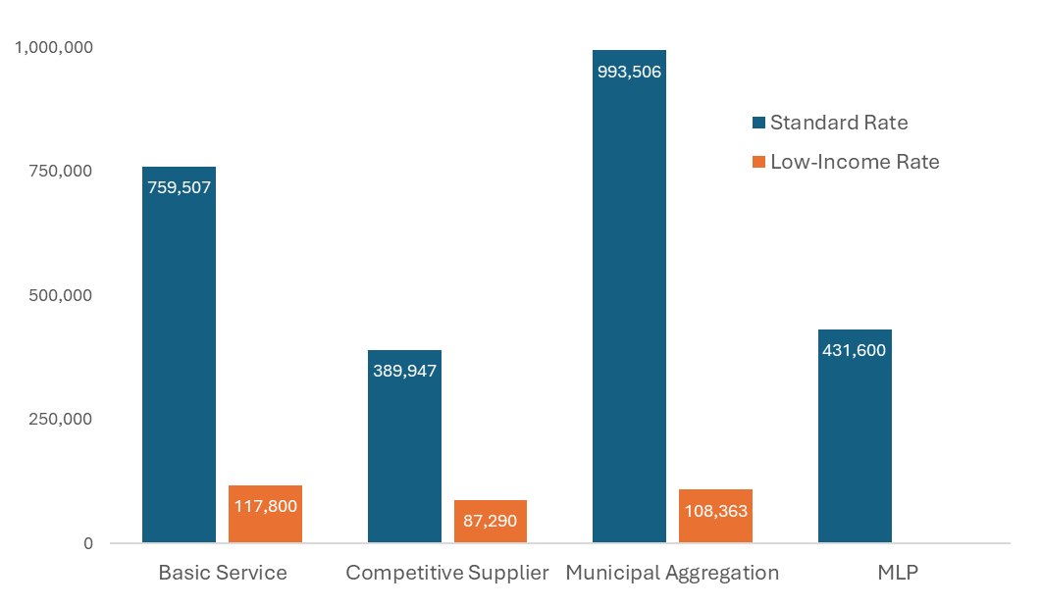
Variability of Electric Supply Rates
As a state with customer retail choice, there is significant variation in the electric supply rates charged to customers.
Customers can receive electric supply through one of three options:
Basic Service – The default supply option provided by a customer’s electric distribution company. This is available to all customers and changes every six months (three months for commercial customers). Supply is procured through competitive procurements and rates are in effect from February through July and August through January.
Municipal Aggregation – Available only to customers in municipalities with approved and active municipal aggregation plans. Rates are typically set for 1-3 year terms, which creates more price stability, but can lead to situations where a municipal rate is higher than current basic service rates at a particular point in time. Many municipalities offer a default rate and one or more optional rates that are priced differently and have different amounts of clean energy (e.g., minimum required by law vs. 100% renewable energy).
Competitive Supply – Available to all customers. Can enroll directly with a supplier via various marketing channels (e.g., door-to-door, telemarketing, mail, website, etc.). Rates are highly variable and range from less than 10 cents per kWh to more than 50 cents per kWh (current Basic Service rates are between 11.8 and 15.6 cents).
Basic Service and Municipal Aggregation rates tend to be comparable but can be higher or lower than each other depending on the time of year.
Number of Residential Customers on Different Electricity Supplier Types

Slide 17
Competitive Supply Cost Impacts
Approximately 15% of customers are currently under contract with a competitive supplier.
The AGO and EEA estimate up to 75% of these customers are being charged supply rates that are higher than basic service or their default municipal aggregation rate.
The Attorney General’s Office analyzed all electric bills issued from July 2015 - June 2024 and found that customers on competitive supply collectively paid $651 million more than they would have if they were on Basic Service.
This data is consistent with analyses performed in every other state with retail choice and was corroborated by an independent analysis conducted by the DPU in 2021.
In addition to confirming that customers on competitive supply were paying higher rates in general, the DPU found that low-income customers were 63% more likely to be enrolled with a competitive supplier than non-low-income customers and paid competitive supply rates that were on average 13% higher than non-low-income customers.
The DPU also found that all distribution customers, regardless of whether they are enrolled with a competitive supplier, pay higher delivery charges to cover the costs of providing higher bill discounts and arrearage forgiveness to low-income customers being overcharged for supply.

Slide 18
Ongoing Efforts to Improve Affordability and Lower Bills
The administration plans to announce several efforts to improve affordability in the coming weeks:
Additional direct energy bill relief to residential customers
Energy Affordability Plan
Energy Affordability and Independence Bill
Other ongoing efforts:
New three-year energy efficiency plans
DPU Energy Affordability Docket (DPU docket 24-15)
Tiered low-income discount rates
New moderate-income discount rates
Roll out of seasonal heat pump rates for National Grid and Unitil customers
Off-peak electric vehicle charging rates (DPU dockets 24-195 through 24-197)
Interagency Rates Working Group Petition to DPU to expand heat pump rates (DPU docket 25-08)
Interagency Rates Working Group Long-term Rate Design Study and Recommendations
Expanded access to community solar programs

Slide 19
APPENDIX

Slide 20
Massachusetts Grid Modernization Advisory Council
Meeting Presentation
January 30, 2025

Slide 21
Electricity Distribution Cost Recovery Background

Slide 22
Electric Distribution Companies
Electric distribution companies (EDCs) build, maintain, and operate the electric grid
EDCs do not own or operate power plants
Instead, electricity in New England is generated by competitive energy suppliers and sold through wholesale electricity markets.
EDCs are regulated monopolies, meaning they are the only company that delivers electricity
Therefore, the prices that EDCs charge for electricity is regulated by the Massachusetts Department of Public Utilities (the Department)
The Department’s mission is to ensure that customers are protected, and that utility companies are providing the most reliable service at the lowest possible cost.

Slide 23
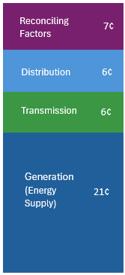
Costs Included in Electricity Rates
Total residential electricity volumetric rate: 39 cents/kWh
Costs of grid modernization, AMI, net metering recovery, storm fund, distributed solar, EV programs, energy efficiency, and more.
Distribution Costs
Regulated by the Department
Cost of wires, poles, and other distribution system infrastructure, including O&M.
Costs of delivering electricity from generators to distribution system
Regulated by Federal Energy Regulatory Commission (FERC)
Costs of supplying electricity including the cost of electricity, renewable energy compliance, and administrative costs
Reflects either cost of power procured by utilities on customer’s behalf or costs of competitive energy suppliers
Figure Notes
Monthly customer charge of $7-10 not included
Rate reflects illustrative 2023 rates for residential customers in Massachusetts
Energy supply rate reflects default service

Slide 24
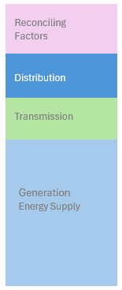
Distribution Costs
Some distribution costs are recovered through base distribution rates
Other distribution costs are recovered through reconciling factors
Distribution rates are set based on the actual costs incurred by the EDC in a recent “test year”
Base distribution rates are set using performance-based ratemaking (PBR)
PBR includes a formula that dictates cost recovery between rate cases:
Allows EDCs to increase costs to account for inflation
Requires EDCs to limit costs to promote productivity gains
A key distinction of base rates is that they do not allow EDCs to recover the exact amount of money spent
If EDCs spend less than the allowed amount – they keep the difference
If EDCs spend more than the allowed amount – they lose the difference

Slide 25
Rate Cases
Rate cases allow for detailed regulatory review of EDC’s distribution costs and rates
With review and input from a variety of stakeholders (i.e., intervenors)
The Department reviews all proposed distribution costs to ensure that they are prudent, reasonable, used, and useful.
Rate cases are also used to ensure that
Costs are allocated equitably across customer classes
Rate designs are equitable across and within customer classes
Rate designs are likely to promote efficient consumption levels
Rates are overall just and reasonable.
EDCs have rate cases every five years

Slide 26
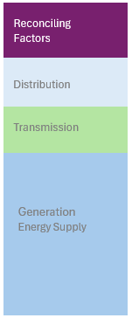
Reconciling Cost Recovery Factors
Reconciling factors are used to recover costs that are not well suited for recovery in base rates, including:
Costs that are volatile and can change significantly between rate cases.
Costs that are somewhat outside of the EDCs’ control.
Costs that are incurred to achieve specific policy goals.
Costs that are likely to change significantly relative to the costs included in the test year.
Reconciling factors are typically determined at the beginning of a year based on forecasted costs for that year.
At the end of the year, any differences between actual and forecasted costs are reconciled
This allows EDCs to pass through ratepayers the amount of money spent
Some reconciling factors are subject to significant stakeholder and regulatory review prior to being put into rates
Example: the energy efficiency programs are reviewed by the Energy Efficiency Advisory Council and approved by the Department before the costs go into rates

Slide 27
Reconciling Cost Recovery Factor Examples
Reconciling factors are used to recover a variety of costs
Examples include:
Pension adjustment factor
Residential assistance adjustment factor
Net metering recovery surcharge
Long-term renewable contact adjustment
Solar cost adjustment factor
Vegetation management factor
Grid modernization factor
Advanced metering infrastructure
Storm cost recovery adjustment factor
Revenue decoupling adjustment factor
Distributed solar (SMART)
Energy efficiency reconciling factor
Renewable energy
Electric vehicle program factor

Slide 28
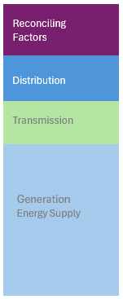
Base Distribution Rates vs. Reconciling Factors
Base Distribution Rates
Reconciling Factors
Rates are set during a rate case
Rates are set every five years
Regulatory review occurs after costs are spent
Includes extensive regulatory review
Cost are based on historical test year costs plus PBR formula
EDCs do not recover the exact amount of costs incurred
Large increases in costs between rate cases are not recovered by the EDC
Rates are set outside a rate case
Rates are set every year
Regulatory review typically occurs before costs are spent
Sometimes includes regulatory review
Costs are typically based on forecast of next year’s cost
EDCs recover the exact amount of costs incurred
Large increases in costs between rate cases are recovered by the EDC

