Slide 1
Heat pump retrofits in Massachusetts 2020-2030
Discussion Points on challenges and directions Will Brownsberger, Updated June 6,2023

Slide 2
Multiple valid planning frames
EoEEA GHG emission tracking – are we meeting statutory climate goals?
Mass Save benefit-cost analysis – how do electrification measure benefits compare to measure costs?
Individual consumer – how is a heat pump installation likely to pencil out financially?

Slide 3
Heat pump planning variables
Installation cost -- $
Operating efficiency -- SCOP, HSPF
Refrigerant leak rates -- % of charge lost annually
Share of heating load -- partial, full, %
Emissions from electricity -- kgCO2e/kwh
Fuel prices -- $/MMBTU
Electricity prices -- $/kwh
Social cost of carbon -- $/MTCO2e
Installation volume
Gas leak rates – from electricity generation and in-home gas heating
Load weighting of heat pump efficiency variation – portfolio SCOP vs. individual mean SCOP

Slide 4
Variable relevance and concerns differ across frames
 | Building Sector Emissions | Public Benefit/Cost | Consumer Benefit Cost
Installation cost
Efficiency -- SCOP
Portfolio SCOP |  | ?
Refrigerant leak rates
Share of heating load
Energy prices
Second order effects
Electricity emissions
Gas leaks (both sides)
Social cost of carbon
Installation volume
Colors: Red/yellow/green – high/moderate/low concern; gray – irrelevant.

Slide 5
In the emissions tracking frame, the clear gap between reality and assumptions is installation volume, but leaks and usage levels could emerge as issues.
2030 electrification goals are challenging -- acceleration required, especially in larger buildings.
Under-used partial conversions could reduce GHG impact.

Slide 6
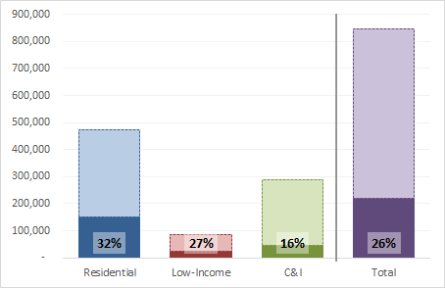
The current three-year Mass Save plan will only accomplish 0.845* MMTCO2e out of 7.7 MMTCO2e required by 2030 – meaning that the next two three year plans will need to move 4x as fast. But even with limited goals in current plan, results are lagging.
Percentage of GHG reductions achieved by sector in current three-year Mass Save plan after 1st Quarter 2023 (42% through plan).
*Note: The total reduction includes a slight net reduction of emissions in the electric sector — electric savings from other Mass Save measures slightly exceed electric increases from electrification. But 97% of the 845,000 MMTCO2e emissions reductions come from the fossil heat sources displaced through electrification and efficiency in the building sector.
This chart is derived from the Mass Save Quarterly KPI Report through 1st Quarter 2023, the GHG tab with a correction to the data range.

Slide 7
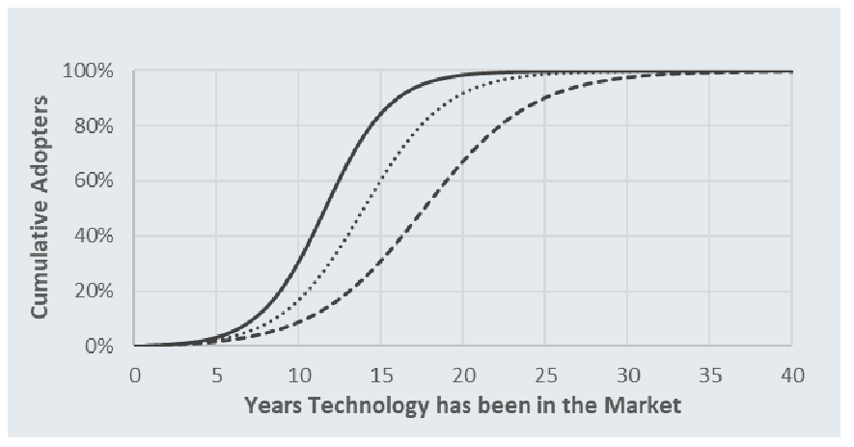
We may spend a few more years on the slow start of the technology diffusion curve.
Graphic from Dunsky potential study submitted in DPU rate proceedings (Eversource Exhibit 1, Appendix F3, page 232)

Slide 8
The Mass Save benefit-cost model is robust at the individual measure level, but installation costs are rising and gas conversions were never shown as cost-effective . . .
Operating efficiency and emissions assumptions are realistic.
Fuel and electricity cost assumptions may be wrong in short term, but using best available long term assumptions.
Refrigerant leaks are not considered, and this can be a material GHG issue if many installed heat pumps are carrying low loads (GHG costs of leaks loom larger relative to GHG operational savings).
Rising installation costs, inflated by incentives, drive down benefit-cost ratios – near 1 for oil displacements depending on SCC assumption and far below 1 for gas displacements.

Slide 9
Heat pump installations are costing more than previously assumed in both medium and long term plans.
Sources: Building Sector Technical Report for Decarbonization Roadmap Study, page 52; Energy Pathways to Decarbonization (p.97); Residential ccASHP Building Electrification Study (slide 30); Eversource Benefit-Cost Model filing in DPU Docket 21-129 – see MeasureYR1 tab, column M; conversations with heat pump installation coaches and others.

Slide 10
Extent of fuel displacement in Mass Save heat pump program has been carefully studied, but is still unknown.
Incentives for whole home heat pumps are awarded without a requirement that existing systems be removed.
No ongoing operational supervision or direct measurement of fuel usage change.
Survey used for measure savings estimation (based on 2019 program participants) includes only 1 whole home respondent.
As to partial conversions the sample is adequately sized, but it is heavily self-selected: Of 2,515 customers, only 328 completed surveys and only 41 consented to usage monitoring.
Mass Save's fuel displacement survey was conducted by a reputable third party, but the low response rate leaves doubt as to customer behavior.

Slide 11
Gas BCRs are < 1 and Oil BCRs may drop < 1 without any allowance for refrigerant leaks
Measure Description | Measure Id | (1) BCR without Midstream at SCC $393 | (1) BCR without Midstream at SCC $ 128 | (2) Derived BCR with Midstream at SCC $393 | (2) Derived BCR with Midstream at SCC $128 | (3) Estimated BCR with Midstream at SCC $190 (EPA) | (4) Estimated BCR with Midstream at SCC $190 with 50% Cost Increase | (5) Speculative BCR with Midstream at SCC $190 with 50% Cost Increase and adjust 20%/50%
Central Ducted Heat Pump Partially Displacing Existing Furnace, Gas | GA2c070 | 0.78 | 0.39 | 1.36 | 0.85 | 0.97 | 0.64 | 0.32
Central Ducted Heat Pump Fully Displacing Existing Furnace, Gas | GA2c071 | 0.44 | 0.17 | 0.95 | 0.57 | 0.66 | 0.44 | 0.35
DMSHP with Integrated Controls Part. Displacing Existing Boiler, Gas | GA2c072 | 0.61 | 0.20 | 0.98 | 0.48 | 0.60 | 0.40 | 0.20
DMSHP with Integrated Controls Fully Displacing Existing Boiler, Gas | GA2c073 | 0.40 | 0.10 | 0.67 | 0.31 | 0.39 | 0.26 | 0.21
Central Heat Pump partially displacing Oil Heat | EA2c266 | 2.38 | 1.51 | 2.72 | 1.80 | 2.01 | 1.34 | 0.67
Central Heat Pump fully displacing Oil Heat | EA2c272 | 2.58 | 1.73 | 2.84 | 1.94 | 2.15 | 1.43 | 1.15
MSHP partially displacing Oil Heat | EA2c268 | 2.39 | 1.52 | 2.70 | 1.75 | 1.97 | 1.32 | 0.66
MSHP fully displacing Oil Heat | EA2c273 | 2.34 | 1.56 | 2.56 | 1.73 | 1.92 | 1.28 | 1.02
BCR’s extracted from Eversource and National Grid BCR Models submitted in DPU filings.
Midstream measures are pre-consumer incentives for distributors to stock higher efficiency ASHPs; should be combined with ASHP measures for full BCR model. Midstream numbers are blended, so derived combined BCRs for retail measures are approximate.
SCC at $190 estimated using linear extrapolation from $393 and $128 values – all model terms affected by SCC are linear and appear in BCR numerator.
50% cost increase is low end of range for incentive driven escalation suggested by anecdotal reports.
Adjust for speculative 20% non-displacement of fuel use in “whole home” cases and 50% reduced displacement in “partial displacements” due to customers preserving comfort.

Slide 12
Average life-cycle refrigerant leakage of near 100% appears reasonable to expect.
State planning documents do not attempt to estimate leakage, but acknowledge the risk.
Available published sources suggest average annual leakage rates of 3-5%, which over a 17 year life translates into 50 to 85% leakage.
Additional leakage can occur in installation, servicing and decommissioning.
See sources collected here.

Slide 13
If consumers use higher cutover temperatures than hoped, the resulting diminished GHG savings may be erased by leaks.
ANALYSIS FOR PARTIAL REPLACEMENT OF FUEL HEATING WITH MINISPLIT HEAT PUMP
Expected annual net winter electric increase from MHSP partially displacing oil (from Eversource Benefit Cost Analysis: EA2c268 combined with Midstream, EA2c004; 91% winter load share from EA2c268 applied to both) | 3,302 kwh
Expected fuel savings – thermal value of oil or gas (EA2c268) | 44.95 MMBTU
Net lifetime GHG saving if displacing oil heat (directly using average marginal AESC .333 kgCO2/kwh; EPA 74.54 kgCO2/MMBTU) | 38.3 MTCO2e
Net lifetime GHG saving if displacing gas heat (directly using average marginal AESC .333 kgCO2/kwh; 53.06 kgCO2/MMBTU) | 21.8 MTCO2e
Benefit cost-analysis assumes average cutover temperature from heat pump to fuel heat in mid 20s (see Fuel Displacement Study Table A-2 through A-4, planned, and compare with Table 4-5, modeled) | Roughly 25 degrees
If true average cutover temperature is in mid 30’s, operating GHG savings would be reduced by 50% (see Table 4-5 in Fuel Displacement Study: savings from baseline of 80MMBtu drops roughly 50% from mid 20s to mid 30s) | 20 MTCO2e (oil), 10 MTCO2e (gas)
Approximate GHG impact of 100% life-time GHG leak – enough to wipe out GHG savings from a partial gas displacement. Mass Save 2.8 tons average installed for minisplit partial equates to > 10lb. of GHG 2000 refrigerant charge, based on example 1.5 ton pump with 7.5 lbs charge. | 10 tons CO2e

Slide 14
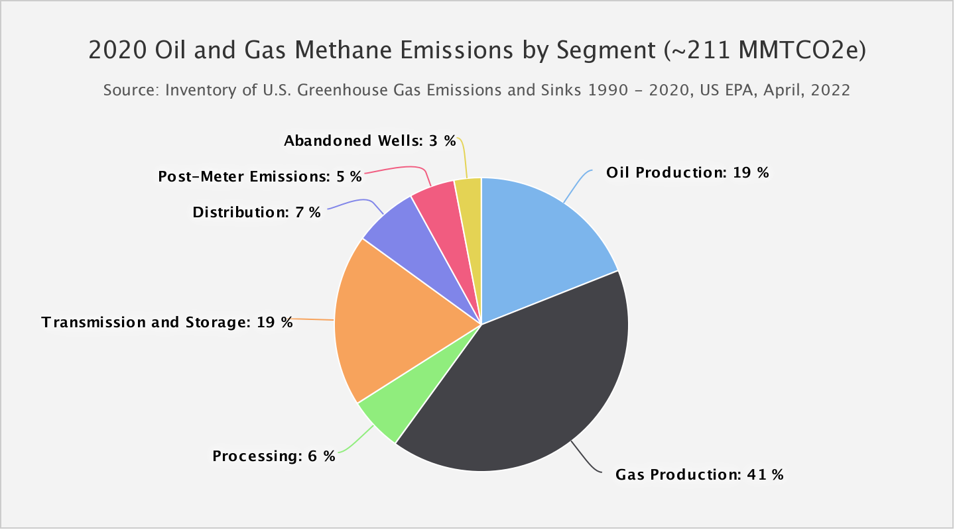
Natural gas leakage most relevant to b-c ratio and applies very roughly equally to natural gas and oil.
Transmission, distribution and storage leaks significant, but system will remain charged – no conversions today allow gas tree pruning.
Post-meter gas leaks associated with furnaces small and usually not altered by conversion.
Natural gas production in 2022 was 44.7 Quads; oil was 24.7 Quads – so methane emissions in production are similar per unit energy.
Source: EPA leak estimates. EIA Production Estimates

Slide 15
Factoring leaks into CO2e emissions equates to a modest increase in social cost of carbon.
Methane's short run GWP is high, 83, but from a harm perspective, the multiplier is lower – 8.4 according to the EPA: "Emissions further in the future produce larger incremental damages as physical and economic systems become more stressed in response to greater climatic change and because income is growing over time."
% leak assumed | % increase in CO2e SCC in BCR Model
1% | 8%
2.5% | 21%
4% | 36%
Sources: EPA SCC announcement; paper on gas leak estimate; computations from physical constants.

Slide 16
Consumers face traps and uncertainties as they consider heat pump installations.
Unrealistic marketing claims about heat pump efficiency are common and widely varying results may lead to consumer bill surprises.
Rising installation costs, inflated by incentives, drive down benefit-cost ratios.
Locally varying electric rates can confuse consumers evaluating costs.
Awareness of risks and need for measurement is low; hard to manage and tune complex systems.
Volatility in fuel and electric rates make future rate savings too uncertain to count on.
Available green financing, encourages borrowing use even where payback may be non-existent or negative.
To achieve comfort when post-retrofit heat distribution is poor, consumers with partial conversions continue to use existing central systems.

Slide 17
Real world studies generally show heat pump performance well below commonly assumed 3.0 SCOP.
Real World Studies | Actual Seasonal COP
Department of Energy (2015): SCOP (seasonal coefficient of performance) for ductless units in 2013-2014. This was a carefully done study, but included only 10 homes. Wide variability. | 2.0
Department of Energy (2018): Only two heat pumps studied; notes that low fan speed may have depressed observed averages. | 2.5
Massachusetts Energy Efficiency Advisory Council Study (2014-6): Over 100 homes with ductless installations. Wide COP range (<1 to > 5). (Values extracted from Figures 30 and 31 by Mike Duclos.) | 1.8 for cold winter; 2.4 for a very mild winter
Vermont Public Service (2017): “ccHPs operated at 88% of the average nameplate HSPF. In situ HSPF varied from 57% to 119% of nameplate HSPF.” Page 29. Many factors influenced in situ results. | 88% of nameplate
Canadian Standards Association (2020): Tested multiple heat pumps using a new test methodology designed to simulate real world variability and challenge the control algorithms of the heat pumps. Measured performance for all tested pumps dropped substantially from HSPF and the rank ordering of heat pumps by performance changed. | Well below nameplate
MassCEC/NYSERDA (2022): Measured seasonal COP of 2.3 across 43 homes, similar results for whole-home and partial conversions. Slide 33. | 2.3, 70% of nameplate

Slide 18
Single Heat 1.5 Ton Pump: Pro Forma Results
Annual Heating Load (lower unit; heavy winter) | 20 MMBtu = 5861.4 kwh
Gas Furnace Efficiency | 90%
Gas required for heating | 222 therms
CO2 rate for Natural Gas from EIA | 52.91 KgCO2/MMBTU
CO2 released from heating with Natural Gas MTCO2 | 1.2 MTCO2
Heat Pump Efficiency | 230%
Electric power required for heating | 2584 kwh
Assumed marginal carbon emissions on grid | 0.3 kgCO2/kwh
Marginal emissions from heating with Heat Pump | 0.8 MTCO2
Emissions Savings Annually | 0.4 MTCO2
Life Time Emission Savings (17 year life) | 6.9 MTCO2
Installed Cost (capital cost only; no operating savings) | $16,500
Cost per ton of carbon eliminated over lifetime | $2,360
% of refrigerant charge (7.25 lbs R410A) beyond which project would be net negative for CO2e | 102%
Cost per ton of CO2e if refrigerant charge leak is 50% | $4,639
Memo: Cost per ton of carbon eliminated if alt is oil and burner efficiency is .85 with no refrigerant leak | $1,099
Memo: Cost per ton of carbon eliminated if alt is oil and burner efficiency is .85 and there is 50% refrigerant leak | $1,425

Slide 19
Gas replacements are exceeding goals, but low-income replacements are lagging.
Source: Program Administrators KPI’s, 4th Quarter 2022

Slide 20
Current high incentives for heat pumps . . .
Are driving costs well above reasonable market levels (unanimous anecdotes)
Encourage investments where GHG results may be minimal (even without refrigerant leaks)
Encourage investments with unreasonable cost per ton of carbon elimination (even without refrigerant leaks)
Are spatially random and do not facilitate gas grid retirement
Lock in gas grid since many (even whole home installs) keep legacy system
Strain HVAC labor force while idling insulation labor force – Mass Save insulation contractors reporting layoffs to EEAC.
May encourage homeowners to borrow in the hope of cost savings that may not materialize

Slide 21
Policy Dilemmas
We are not achieving our stated GHG reduction goals.
We want to support heat pump industry maturation, but current high incentives combined with broad lack of expertise are leading to mixed results for consumers.
Currently chosen pathway assumes migration off natural gas grid but
Heat pump conversions from natural gas are mostly not cost effective even assuming a high social cost of carbon
Geographically random partial conversions are not, in fact, positioning us for a gas transition
Coordinated transition is challenging (network logistical complexity; consumer preferences)
Insulation workforce is under employed
Least electrification progress in low-income sector

Slide 22
Policy Options
Lower electric rates relative to fuel rates
Move efficiency and other charges off electric rates
Allow maximum flexibility for IOU purchasing of power
Expand base for efficiency charges to include oil and propane
Raise Mass Save quality standards
Require demonstration of measure cost-effectiveness for consumers with appropriate discount rate reflecting uncertainty of future benefits (higher than program or social discount rate)
Tie program administrator incentive awards to random audit results for both insulation and heat pumps; Mass Save should be accountable to consumers for truth of promotional material
Require inclusion of leaks in benefit-cost analysis
Consider approaches to improving contractor accountability for results
Support research to help evolution of best practices
Consider how to increase intersectionality with housing and equity goals
Re-emphasize envelope efficiency measures that increase housing quality
Emphasize low and moderate income rental housing conversions (focus especially on electric resistance heat – no risk of bill increases)
Continue experiments with coordinated gas and electric transitions
Support heat pump technology improvements
Near term refrigerant changes need code change
Medium term design changes may or may not need additional

Slide 23
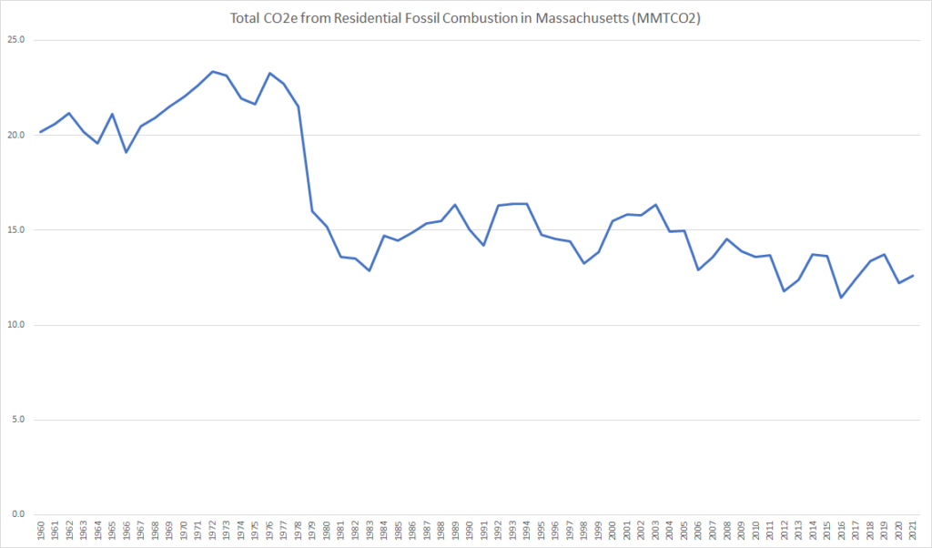
How can we bend the curve further?

