Slide 1
Covid Vaccine Rollout
Discussion on January 27, 2021

Slide 2
Agenda
Pandemic Context
National Vaccine Distribution Process
State’s Phased Distribution Plan
Getting Vaccinated Now
Quick Poll on Experiences
Discussion

Slide 3
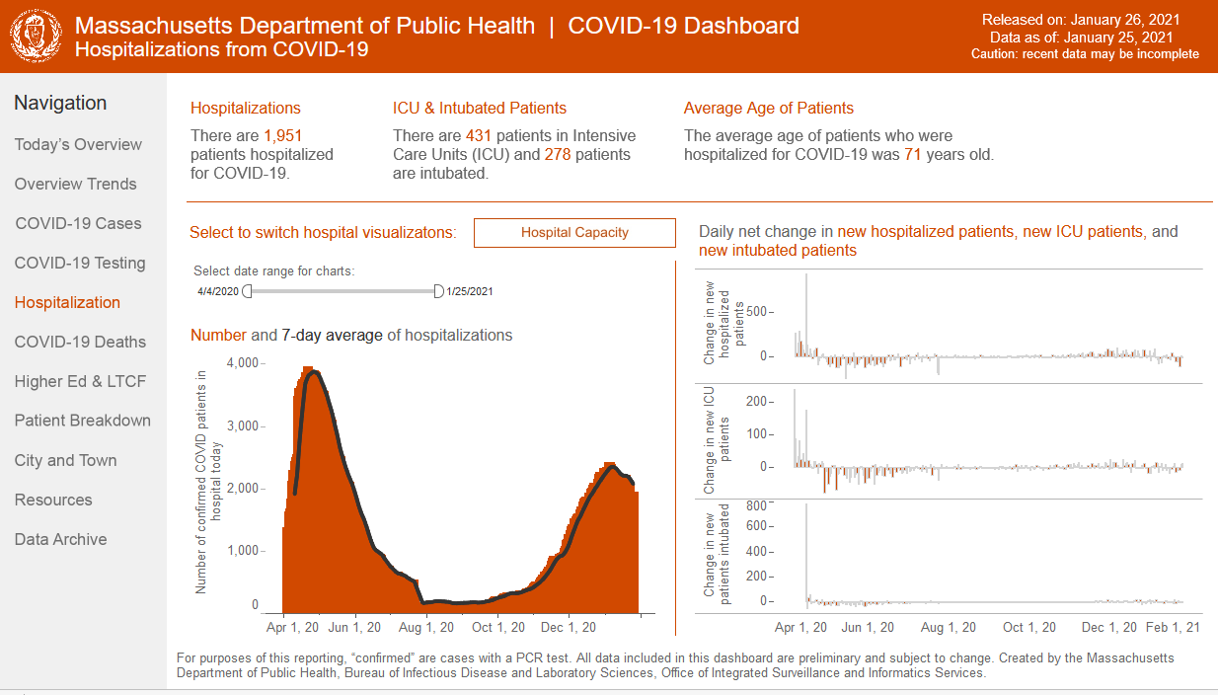
Pandemic Context
https://www.mass.gov/info-details/covid-19-response-reporting#covid-19-interactive-data-dashboard-

Slide 4
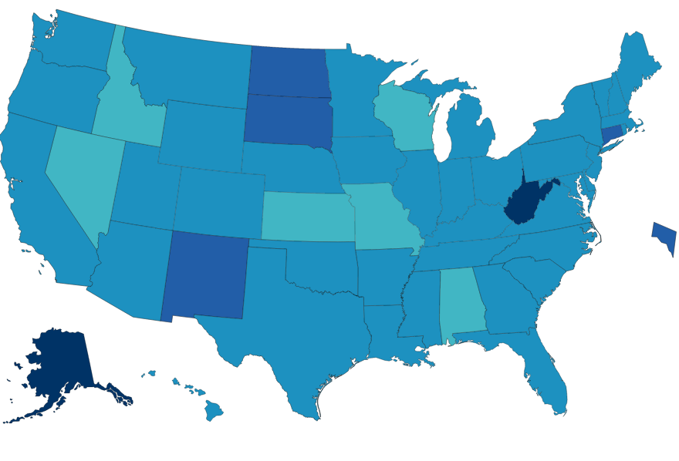
https://covid.cdc.gov/covid-data-tracker/#vaccinations
National Vaccine Distribution Process

Slide 5
State’s Phased Distribution Plan
https://www.mass.gov/info-details/covid-19-vaccine-distribution-timeline-phase-overview#phase-1-
Phase 1 (December 14)
Health Care Workers
First responders
Phase 2 (February 1)
75+
65+ or 2 comorbidities
Phase 3 (April?)
General Public
Group residents
Teachers
Other essential

Slide 6
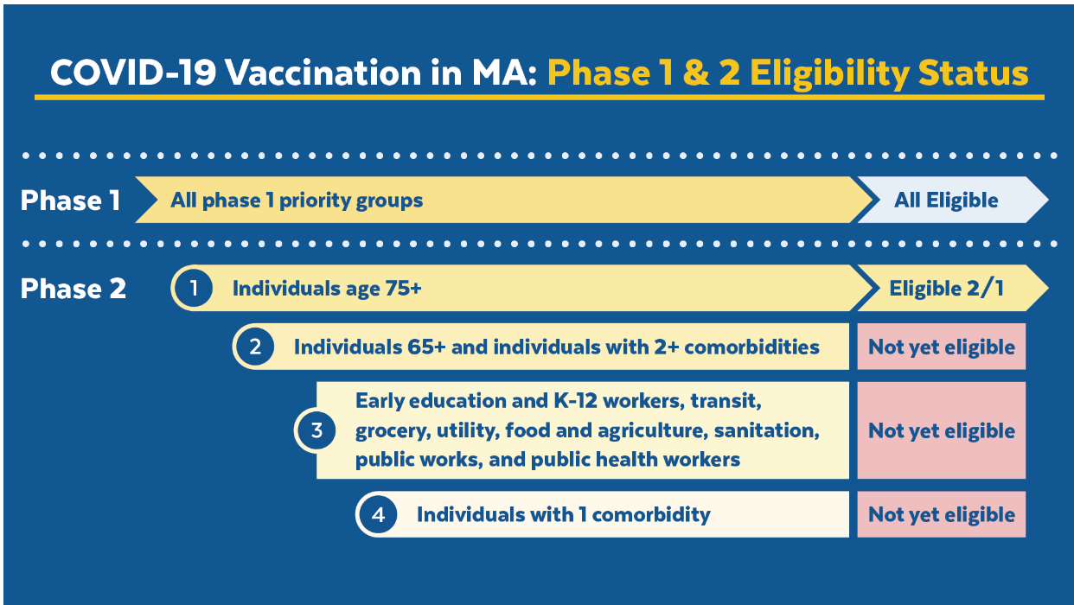
Getting Vaccinated Now
https://www.mass.gov/info-details/covid-19-vaccination-locations-for-individuals-in-eligible-groups-and-phases

Slide 7
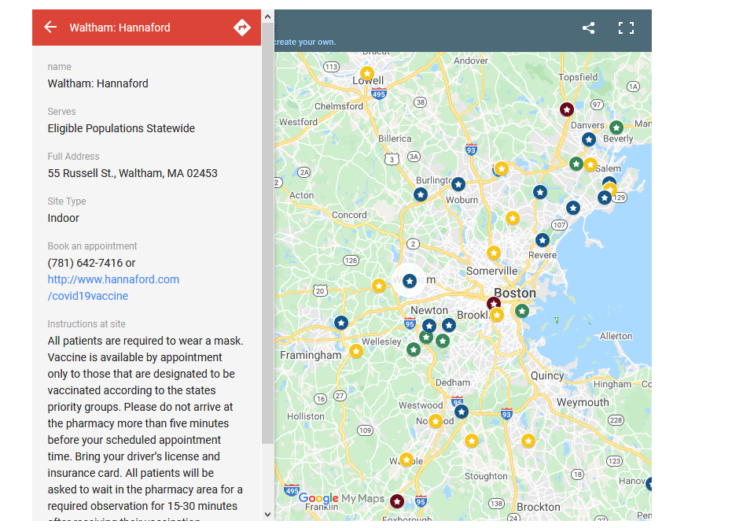
https://www.mass.gov/info-details/covid-19-vaccination-locations-for-individuals-in-eligible-groups-and-phases
Getting Vaccinated Now

Slide 8
https://www.mass.gov/info-details/covid-19-vaccination-locations-for-individuals-in-eligible-groups-and-phases
Getting Vaccinated Now
Site | How they said no
Fenway | Link to register for an appointment coming soon
Reggie Lewis Center | Check back soon for a link
South Boston CHC | Thank you for your interest. All of our appointments are currently full.
Wegmans | Blank screen
Holtzman Medical Group | No times are available in the next month . . .
CVS | None of your selected vaccines are available nearby . . .
Atrius Health | We are currently booking appointments for individuals in Phase 1 priority groups only.
MAImmunizations.org | No clinics to show.
Waltham: Hannaford | There are no locations with available appointments within 30 miles . . .
Arlington Family Practice | All appointment times are currently reserved. Please check back again later.
Gillette Stadium | “No appointments available” for today, 1/27/2021 and no link to tomorrow.

Slide 9
Getting Vaccinated Now

