Slide 1
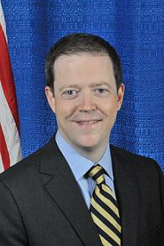
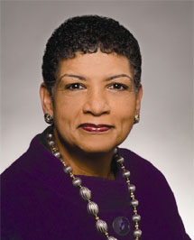
GREEN LINE OVERVIEW May 2014
Richard A. Davey
MassDOT Secretary and CEO
Beverly A . Scott, Ph.D.
MBTA General Manager
MassDOT Rail & Transit Administrator

Slide 2
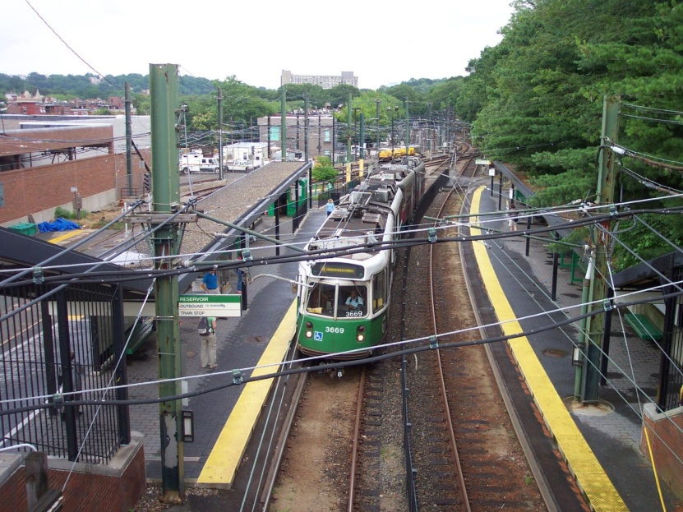
Green Line: About
226,000 weekday riders
205 Vehicle Fleet
111 Type 7’s (1987, 1997)
94 Type 8’s (2007)
26 miles of track
23 miles of overhead catenary wire
64 grade crossings
91 switches, 497 signals, 497 track
circuits, and 40 switch heaters
10 unit sub-stations
750,000 feet of DC feeder cable
2,019 MBTA parking spaces
66 stops/stations
Notes:
Green Line Ridership by Segment (typical weekday boardings)
“B” Line- Boston College via Comm. Ave: 28,486
“C” Line- Cleveland Circle via Beacon St: 14,718
“D” Line- Riverside via Highland Branch: 22,922
“E” Line- Heath St. via Huntington Ave: 19,149
Top 5 Highest Ridership Stations: Coolidge Corner, Harvard Ave, Longwood Med. Area, Prudential, Brookline Village
Additional Green Line Information
46 miles of track
23 miles of overhead catenary wire
64 grade crossings
91 switches, 497 signals, 497 track circuits, and 40 switch heaters
10 unit sub-stations (circuit breakers, transformers, and distribution equipment)
750,000 feet of DC feeder cable [30 years useful life]
2,019 MBTA parking spaces

Slide 3
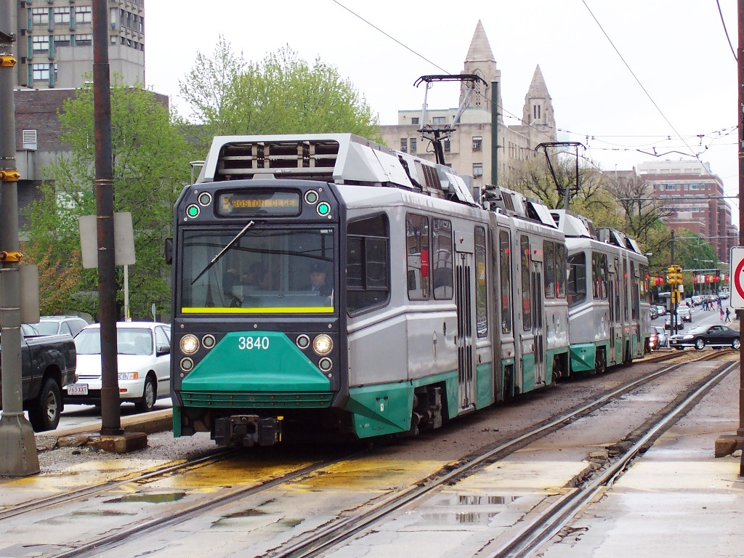
Green Line
Speed
Frequency
Capacity
Transparency
Accessibility

Slide 4
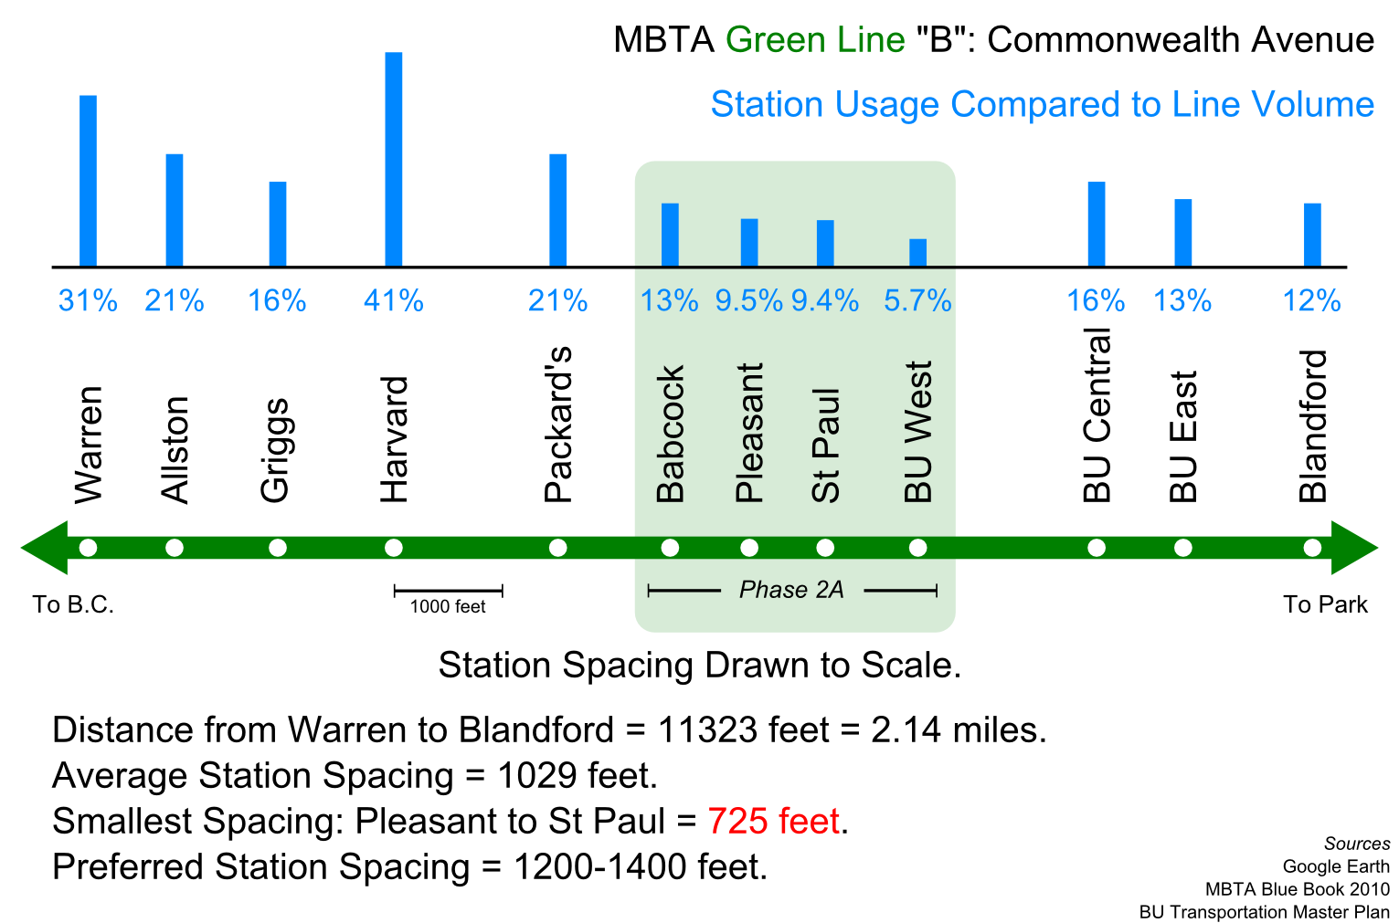
Speed
Stop Consolidation:
Preferred Station Spacing: 1,200 – 1,400 feet
Notes:
B Line before 2004 consolidations average spacing= 997 feet
B Line after 2004 consolidations average spacing= 1,231 feet
Average spacing of Babcock, Pleasant, St. Paul and BU West= 695 feet→ STATIONS TOO CLOSE
B Line customers in the aggregate saved a net 28.4 passenger-hours of travel time each day with the 2004 change, or over 8,000 passenger-hours each year
Survey data from 2005 showed widespread support for the consolidation effort.
B Line average travel speed: 7.8 MPH
C Line average stop spacing: 998 feet
C Line average stop spacing: 6.9 MPH
D Line average stop spacing: 4026 feet
D Line average stop spacing: 19.5 MPH

Slide 5
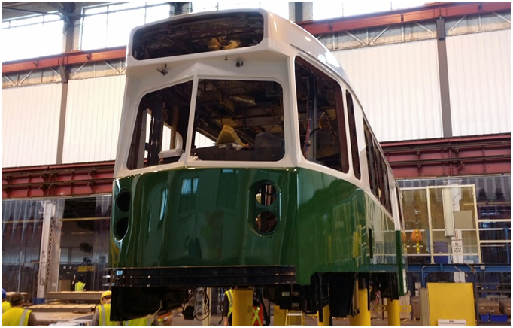
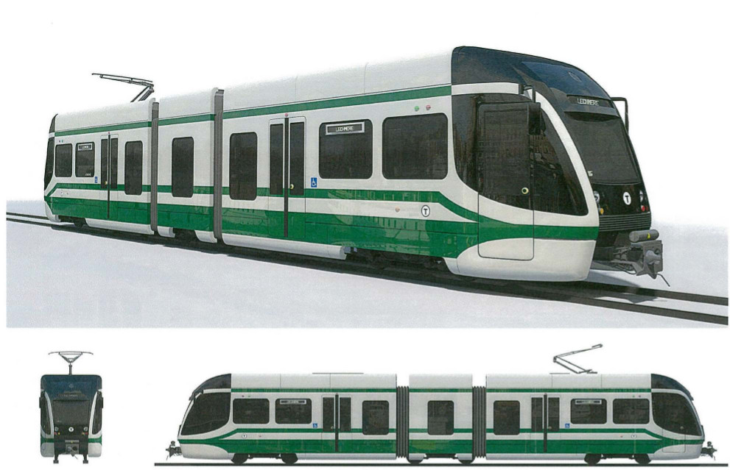
Frequency
Increase Fleet Size:
Overhaul of Type 7 and Acquisition of Type 9
$140.6 million invested in fleet reliability
$164.0 million invested in fleet expansion
Notes:
Frequency: Peak/Off-Peak Scheduled Headways by Line (weekdays)
“B” Line- Boston College via Comm. Ave: Peak=7 min Off-Peak=9 min
“C” Line- Cleveland Circle via Beacon St: Peak=6 min Off-Peak=10 min
“D” Line- Riverside via Highland Branch: Peak=7 min Off-Peak=11 min
“E” Line- Heath St. via Huntington Ave: Peak=6 min Off-Peak=8 min
Key Activity Centers: Boston College (B), Boston University stations (B), Coolidge Corner (C), Fenway (D), Copley (E), Prudential (E), Symphony (E), Northeastern (E), Museum of Fine Arts (E), Longwood Medical Area (E), North Station and Downtown Boston area stations
The MBTA Green Line Fleet consists of 215 cars and is comprised of three different vehicle types:
111 Type 7 cars manufactured by Kinkisharyo (late 1980s)
94 low floor Type 8 cars manufactured by Ansaldo Breda (early to late 2000s)
Current service levels require 146 vehicles for peak revenue service on the green line
The Type 7 Fleet is undergoing a Selective Systems Improvement Program designed to improve vehicle reliability and performance:
86 Light Rail Vehicles being overhauled by Alstom Transportation in Hornell NY, for a total contract price of $115 Million
Vehicles originally delivered by Kinkisharyo in 1986-87
Scope of work to focus on preserving the integrity of the structure, roof, and exterior, and also to restore the reliability
Key benefits to riders include:
Convert to all LED lighting
New seats and interior
ADA compliant door warnings and signals
Improved HVAC capacity
Pilot Vehicle to be delivered early Fall 2014, Final Vehicle to be delivered Fall of 2016
Governor’s “Way Forward” plan calls for replacement of the Green Line Type 7 and Type 8 Fleet In 2020

Slide 6
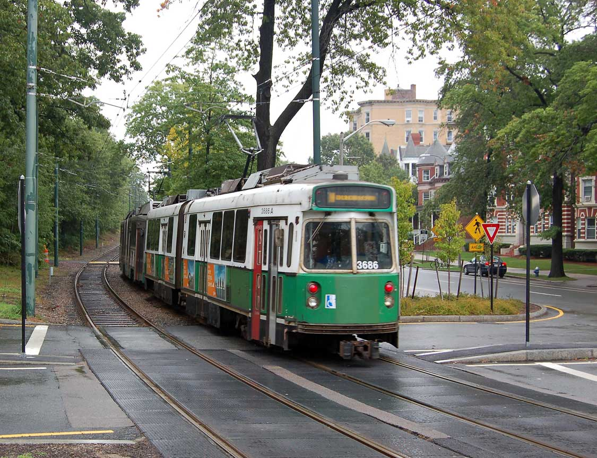
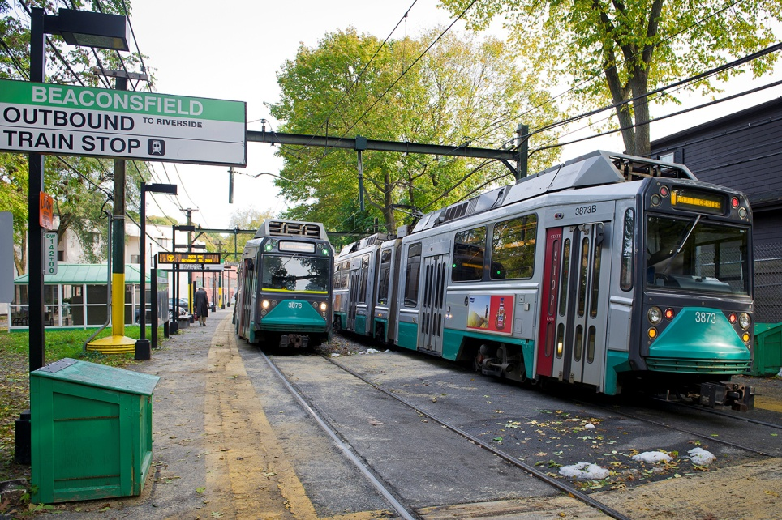
Capacity
3 Car Trains:
$3.9 million investment to study power system upgrades to run more 3 car trains at peak
Notes:
Green Line Power Study: funds a study of power needs and capacity on the Green Line based on use of No. 8 car= $3.93 million FY14-18
Green Line Frog Replacement Program: includes survey, design, and fieldwork necessary to replace existing frogs (to enable crossovers between tracks) throughout the Green Line= $5 million FY14-18
*note on 3 car trains: MBTA current power system limits additional 3 car trains at peak periods

Slide 7
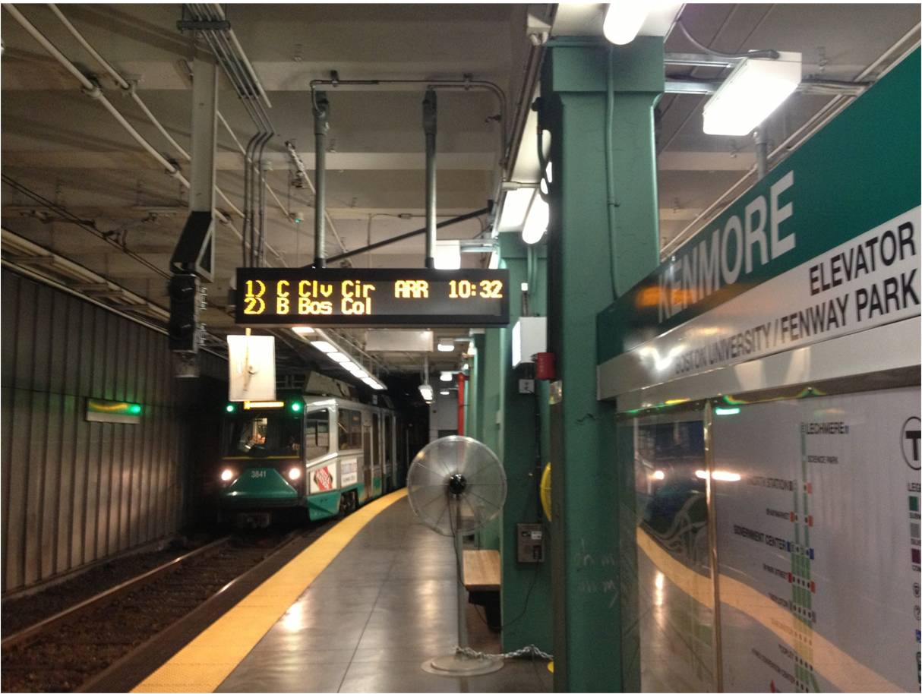
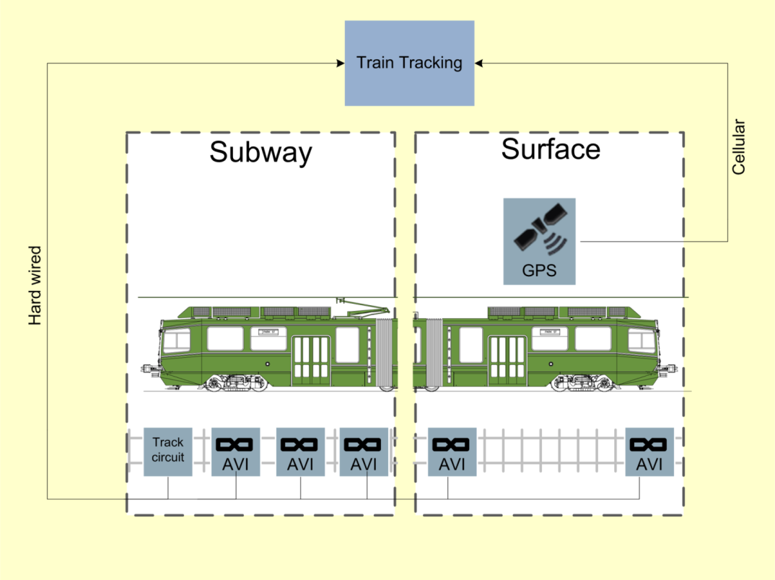
Transparency
Green Line Tracking:
December 2014 Planned Launch
Notes:
Green Line Real-Time Tracking System: project covers both a consolidated real-time prediction and alerts system and a full CAD/AVL system for the Green Line= $13.43 million FY14-18
Planned launch: December 2014
Planned countdown signage and apps: 2015
Critical step towards TSP and PTC

Slide 8
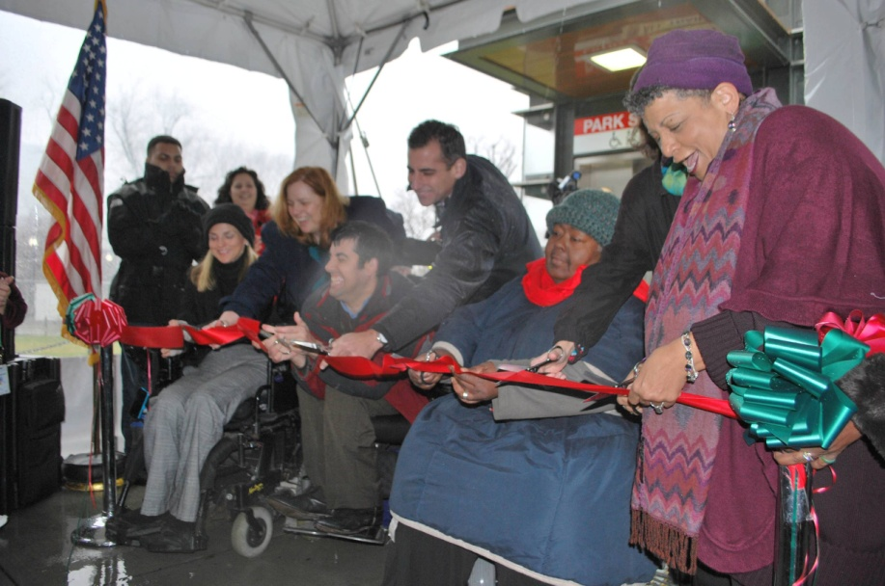
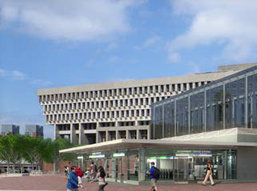
Accessibility
Station Upgrades:
Park St Station Elevators
Government Center Overhaul
PATI
Plan for Accessible Transit Infrastructure
Notes:
Green Line Interim Accessibility Improvements: funds construction of temporary platforms and lifts at several Green Line stations=$1.44 million in FY14-18
Green Line Light Rail Accessibility Program- Surface Stations (B, C, & E Lines): includes raising platforms, installing new kiosks, benches, signage and other necessary improvements to make stations ADA accessible; other misc. improvements: new headhouses, new installation of elevators and escalators, new shelters, and new lighting=$32.7 million authorized budget
Stations include: Park Street, Haymarket, Government Center, Arlington, Copley, Kenmore, Boston College, Brookline Village, Longwood, Symphony, Hynes, Science Park, and Wollaston Stations
Government Center Station: includes new headhouse on City Hall Plaza, new raised platforms, new electrical substation, installation of a new elevator, LED signage and accessible fare collection equipment=$67.79 million in FY14-18
Park Street Stair Replacement: funds the replacement of the steel staircase structures leading to the upper level of Park Street station= $0.8 million in FY14-18
Plan for Accessible Transit Infrastructure (PATI) is an initiative to identify barriers to accessibility within the MBTA’s infrastructure and to understand which barriers warrant the highest priority for removal. This undertaking is broken down in into 3 phases:
The PATI team is currently developing high-level accessibility survey tools tailored for each asset type: commuter rail, light rail, heavy rail, bus stops, ferry terminals, silver line stations and other MBTA facilities utilized by the public. We have just developed a beta tool for Commuter Rail Stations and will be working on tools for bus stops and subway stations next.
All stations and stops will be surveyed
As the survey is underway, we will develop criteria to prioritize spending on accessibility initiatives, which will reflect, among other things, work planned as part of the Capital Improvement Program and State of Good Repair, as well as ridership, system transfer points, major activity centers and other factors.
*We expect this entire process to take roughly 18 months

Slide 9
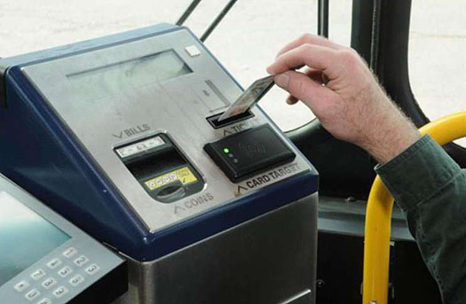
Green Line Mid-Term Improvements
Fare Evasion:
Front Door Boarding Policy
Reduce Use of Tickets
Traffic Signal Prioritization:
Improve Street Level Speed
Capacity Study:
Identify power needs on the Green Line
Notes:
Green Line Power Study: funds a study of power needs and capacity on the Green Line based on use of No. 8 car= $3.93 million FY14-18
Park Street Station Eastbound Crossover: funds modification of track scheme and power sectionalization on Green Line at Park Street; by creating a short track connecting the two eastbound tracks, the project will dramatically increase eastbound service, eliminate the station as a major bottleneck and source of standing time delays, and allow greater operational flexibility; will increase service speed and reliability for Green Line passengers=$3.28 million FY14-18
Green Line Positive Train Control: project purpose is to identify technologies that can improve safety by reducing/eliminating collisions under current operating costs=$2.73 million authorized budget
Late Night Service

Slide 10
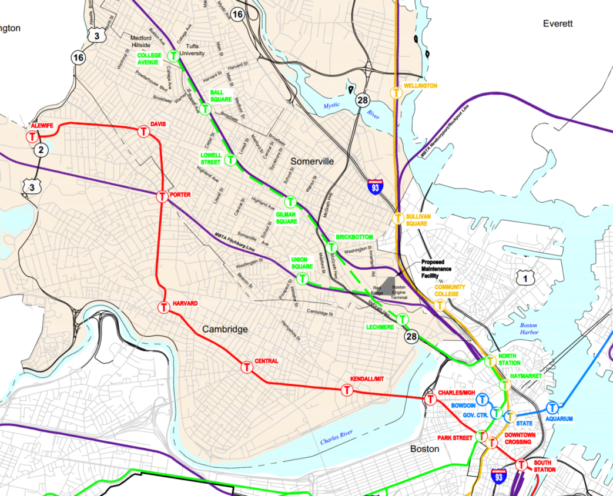
Green Line Long-Term Improvements
Green Line Extension (GLX)
New Facilities
Power System Overhaul
Additional Stop Consolidation
New Fare Collection strategies

Slide 11
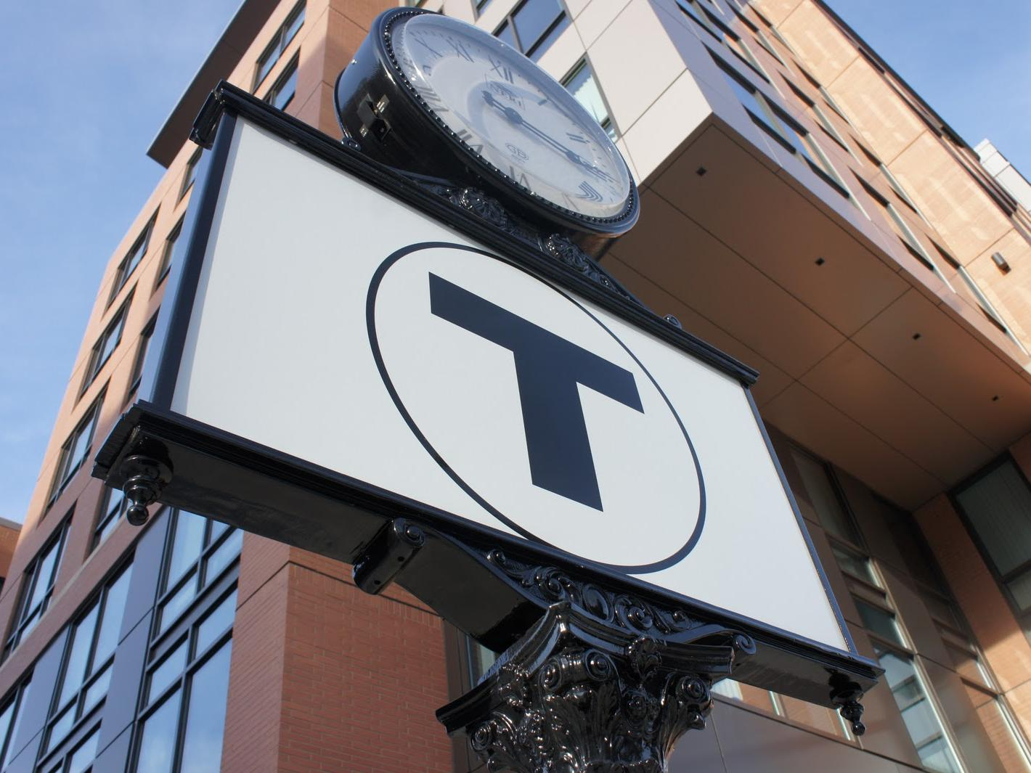
Thank you
Take the MBTA Survey @ mbtasurvey.com

