Slide 1
A Brief History of Agricultural Technology
Why GMO’s are a concern
with many Americans !
Senate District Forum on GMO’s & GMO Labeling
Watertown, MA October 20, 2015
Jim Tillotson

Slide 2
Why do we develop new farming technology ?

Slide 3
Traditional Reasons
Increase crop production
Increase farming efficiency
Environmentally Sounder technology
Safer technology
Arising New Reasons
- Limits on new arable land
- Increasing limits on water for agriculture
- Climate change

Slide 4
The World’s Population
1950 2.5 billion people
2000 6.1 billion people
2015 7.3 billion people
2050 9.6 billion people (projected)

Slide 5
Eras of American Farming Technology Development
19th century – Mechanical era -
-Mechanization of Agriculture -
1930 – 1980 - Green Revolution -
Chemical era-
1995 – present– Genetics & Digital era
- Second Green Revolution -

Slide 6
A plant GMO’s is produced by the insertion of genes from a different specie into the plant’s genetic code enabling the plant’s seed to grow a crop with a new trait(s)

Slide 7
The first major GMO crop product commercialized in 1995 was a genetically modified seed – Monsanto’s Roundup Ready Seeds - currently the majority of GMO’s food crops planted are of this type of GMO’s

Slide 8
Glyphosate is a herbicide used to kill crop weeds that compete with commercial crops .

Slide 9
Global Status of Commercialized Biotech/GM Crops Today
In 2014 181.5 million acres were grown globally with GM crops, planted by 18 million farmers in 29 countries
By 2010 biotech crops were grown on ~ 10 percent of all cropland in the world – primarily in USA, Brazil, Argentina, India, Canada & China
Leading GM crops are corn, soybean, cotton, canola, sugar beets and alfalfa
The vast majority of commercial to date have been grown from Roundup Ready seeds

Slide 10
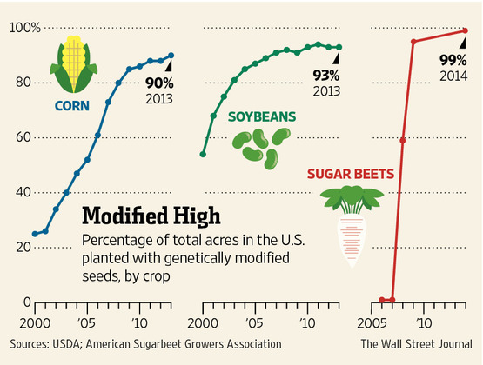

Slide 11
Accompanying the increased use of this GMO – Roundup Ready seeds – there has been growing concern over their use for a variety of reasons including human safety, environmental, economic, and social issues

Slide 12
US Farming Today
In the United States we have largely moved from the family farm model for majority of agriculture production to large commercial farming enterprises
The use of farming technologies has been a major factor in this occurring However, much of established farming technology is reaching its limit in increasing crop productivity and has it negative factors
Because of projected rising global population, environmental issues and limitations of land and water for agriculture, there is a need to develop further farming technology and Biotech (GMO’s) are a leading option

