Slide 1
Michael Wong, MD
Sr. Medical Director, Infectious Diseases
Sarepta Therapeutics
Associate Professor of Medicine, Infectious Diseases
Harvard Medical School/Beth Israel Deaconess Medical Center
Public Health Council
Massachusetts Department of Public Health
5th EU-US eHealth Business Marketplace and Conference
October 21, 2014

Slide 2
Outline
Ebola as a Public Health Threat
Background
Timeline and WHO response
“Isolation”: Protection, mismessaging, and stigma
Potential Therapeutics and Preventive Vaccines
World response and role for harmonization

Slide 3
RECENT EBOLA OUTBREAK
Medscape [Image]. Retrieved from www.medscape.com/view/ebola /19_JUN_2014

Slide 4
Ebola
Fuse via Getty Images. [Image]. Retrieved from http://www.huffingtonpost.com/2014/10/12/cdc-ebola-texas_n_5973726.html

Slide 5
Ebola Genome
NP: Nucleoprotein
VP35: Polymerase cofactor
VP40: major structural protein; viral assembly and budding
GP: (glycoprotein) binds to the NPC1 cholesterol transporter protein on mammalian cells
VP30: Transcription activator protein
VP24: Intrinsically blocks normal interferon signaling responses within cells
L: RNA polymerase

Slide 6
Impact of Nonhuman Primates
Human outbreaks are heralded by acute NHP mortality
Monkeys, gorillas, chimpanzees and duikers ¹
Occasionally associated with caves and bat exposure
Bats are natural hosts; they survive infection as do other rodents, but during viremic phase shed virus through feces. ²
Direct spread to humans and NHP occurs via exposure to excretions or oral contamination; cooking inactivates virus.
Domestic pigs have been infected with less virulent biosimilar strains (RESTV)³
Handlers seroconverted without illness
Experimental pig infections by mucosal exposure demonstrates pulmonary epithelial pathology and transmission of disease among cohabitating pigs⁴
1. Swanepoel R et al. Emerg Infec Dis 1996;2:321-25; 2. Leroy EM, et al. Science 2004;303:387-90; 3. Barrette RW et al. Science 2009;325:204-6; 4. Kobinger GP et al. J Infect Dis 2011;204:200-8

Slide 7
Ebola
Incubation reported between 2-21 days
Initial symptoms include fever, malaise, myalgias, the bleeding, coagulopathy and CNS involvement
At present, there is no licensed cure or vaccine
Transmission is contact to blood and body fluids; unclear if there is an airborne component*
Isolation precautions including contact tracing, and personal protective equipment are crucial for containment and care
Supportive measures including hydration enhance survival
*There are data supporting airborne transmission among bats, but this has not been demonstrated in human outbreaks.

Slide 8
Ebola Viral Disease
Average symptom onset to death: 7 days
Average symptom onset to recovery: 15 days
Case Fatality Rate: 54.9% (probably higher)
The Basic Reproduction Number (Ro) of an infection can be thought of as the number of new cases generated from one case in an otherwise healthy population:
EVD 2014: Guinea 1.4; Liberia 1.48; Nigeria 1.4; SL 1.6
EVD historically: 1995 Congo 1.3, 2000 Congo 2.7
Cholera: 2.4
SARS: 2.0-5.0
Data from Guinea, Liberia and Sierra Leone (VSHOC Ebola database, 25 Aug 2014; Imperial college & University of Oxford (USCDC/WHO RO/WHO HQ 27 Aug 2014)

Slide 9
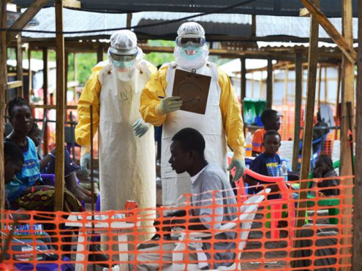
Ebola Outbreak History
Discovery of Ebola in 1976
23 outbreaks through December 2013
9216 human cases resulting in 4555 deaths (CFR 50%) by 17 October 2014
As of September 2, 2014 West Africa has reported 3540 cases and 1875 deaths (CRF 53.0%)
First identified transmitted cases reported in Spain and US this month
CDC estimates >1M infected by January 14, 2015
Source: WHO Ebola Update, 17 October 2014. www.apps.who.int/iris/bitstream/10665/136645/1/radnaoyodate17oct14_eng.pdf

Slide 10
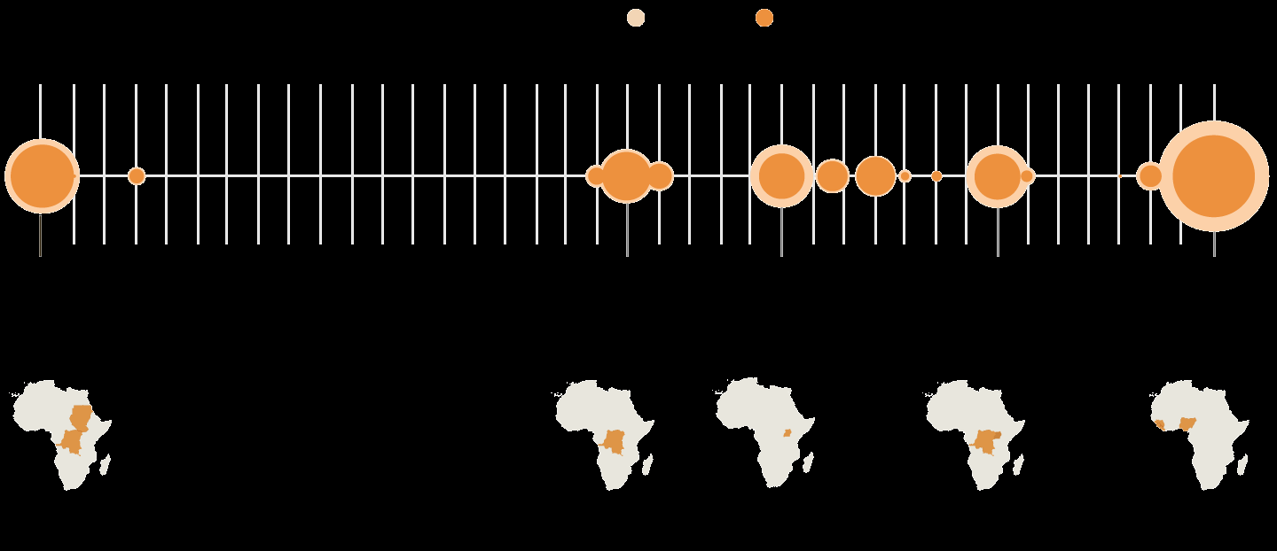
Ebola Outbreaks, 1976-present
Cases
Deaths
1976
1995
2000
2007
2014
2nd worst year
Sudan, Democratic
Republic of Congo
5th
Democratic Republic of Congo
3rd
Uganda
4th
Uganda, Democratic Republic of Cong
1st
Sierra Leone,
Guinea, Liberia, Nigeria
602 cases
431 deaths
71.5% mortality
315 cases
254 deaths
80.6% mortality
425 cases
224 deaths
52.7% mortality
413 cases
224 deaths
54.2% mortality
9216 cases*
4555 deaths
50% mortality
* As of October 17, 2014
Adapted from NYTimes:.com http://www.nytimes.com/interactive/2014/07/31/world/africa/ebola-virus-outbreak-qa.html

Slide 11
Characteristics of 2014 Ebola Outbreak
Unprecedented geographical spread: major global health security concern
3 countries with intense transmission, including the capital cities of Guinea, Liberia, and Sierra Leone
5 countries with imported cases as of 10/10/14*:
Nigeria, Senegal, Macedonia, Spain and US
Secondary transmission seen in Spain and US as of 10/12/14**
Unrelated recent outbreak: Democratic Republic of Congo
Burden on health system infrastructure
High number of healthcare workers infected impacting an already weak system
Specific protocols and infection control procedures difficult to follow and require sustainable supplies (Isolation wards, PPE, disinfectants)
Primary healthcare services not sustainable including IV tubing, IV fluids, retractable needle devices, bedding, laboratory services.
*Positive News: Senegal and Nigeria report Ebola eradicated from their countries; Quarantine period for 43 Healthcare Workers in Dallas ends
*Source: http://www.cnn.com/2014/10/20/health/ebola-outbreak-roundup/index.html

Slide 12
Burden on Health Systems
Country | Physician Density Number per 100 000 population | Nurse and Nurse Extender Density: Number per 100 000 population | Total Population
Guinea | 1/100,000 | No data | 11,451,000
Liberia | 1/100,000 | 27/100,000 | 4,190,000
Sierra Leone | 2/100,000 | 17/100,000 | 5,979,000
United States | 2.4/1000 | 9.8/1000 | 319,052,968
Data source: WHO countries profiles/CIA World Factbook, 2014.
Ebola impact on HCWs as of 1 September 2014:
Country # Deaths
Guinea 45
Liberia 145
Sierra Leone 55

Slide 13
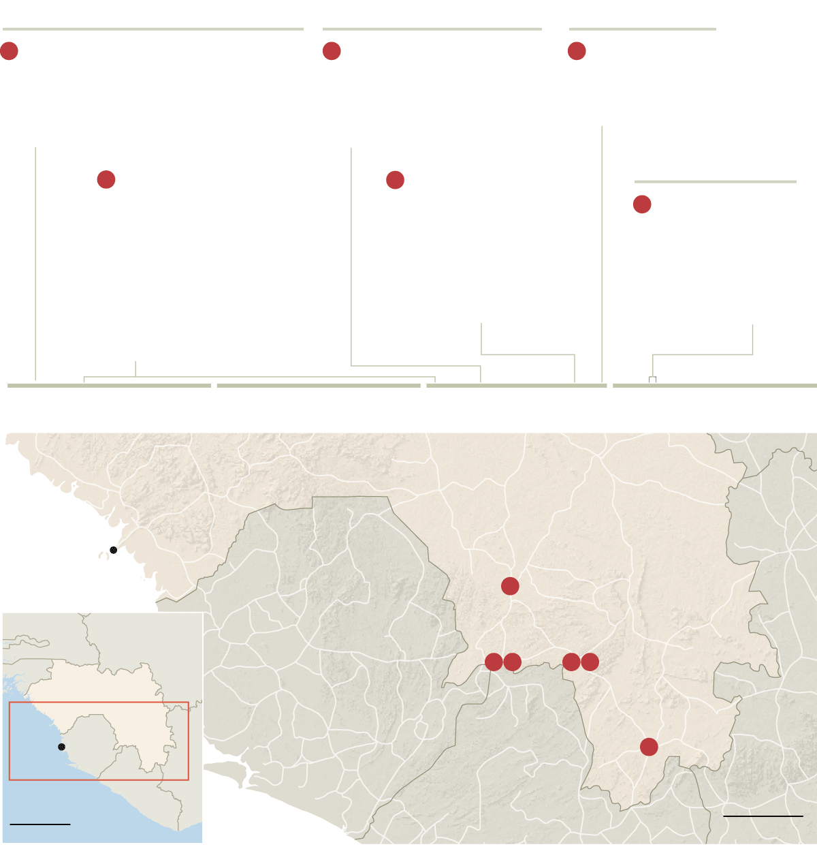
Melaindou Village, Gueckedou, Guinea
Macenta, Guinea
Nzerekore, Guinea
1
Dec 6, 2013
The suspected first case, a 2 yr old child living in Meliandou Village, Gueckedou, dies after being sick for 4 days
3
Feb 10, 2014
A health care worker from Gueckedou hospital dies at Macenta hospital after being sick for 5 days
5
Feb 28, 2014
A relative of the Macenta hospital doctor dies in Nzerekore
1
Dec 13, 2013 to
Feb 2, 2014
The child’s sister, mother and grandmother die. The village midwife is hospitalized in Gueckedou and also dies
Feb 24, 2104
A doctor at Macenta hospital who treated the health care worker dies. His funeral is held in Kissidougou
Kissidougou, Guinea
2
4
6
Mar 7 and 8, 2014
Two of the Macenta doctor’s brothers die in Kissidougou
December 2013
January 2014
February 2014
March 2014
GUINEA
COTE D’IVOIRE
Conarky
Kissidougou
6
SENEGAL
MALI
SIERRA LEONE
Guedkedou
Macenta
1
2
3
4
GUINEA
Area of Detail
Nzerekore
Freetown
5
LIBERIA
LIBERIA
200 miles
50 miles
NY Times, http://www.nytimes.com/2014/08/13/world/africa/ebola.html?_r=1#story-continues-1

Slide 14
Data based upon internal surveillance programs.

Slide 15
Data obtained AFTER specific international and WHO based steps started.

Slide 16
Challenges
First outbreak in West Africa; therefore unlike DRC, there is a lack of understanding within local communities, lack of experience among HCWs, and limited capacities for rapid response.
High level of community exposure– through household care and customary burial practices, leading to fear, panic and resistance to proposed response measures
Close community ties across border areas impacting on care-seeking behaviors and contact tracing
Magnitude and spread of the outbreak in the 3 most affected countries requires enormous commitment of resources and robust sustained response capacities
Surveillance systems flawed: rely on reporting of cases that come to medical attention, and as we’ve learned, self reporting is significantly sub-optimal, borders are highly porous, and because of misbeliefs and stigma associated with the diagnosis, many are not stepping forward for early testing.
Already international spread into 5 countries; 4 with secondary infections including Senegal, Nigeria, Spain and US
EG: Senegal: 1 patient with up to 75 contacts; 34 being family members, remainder HCWs distributed across 36 homes in 5 districts
US: 1 case with 84 contacts including ~40 HCWs from first presentation, as of Oct 14, 2014, 2 HCW documented with Ebola infection.

Slide 17
International Response
2-3 July: Emergency Ministerial meeting in Accra, Ghana with 13 Ministers of Health
8 August: WHO declares Public Health Emergency of International Concern
IHR Recommendations on outbreak response and travel in affected countries, to neighboring countries and all countries
11 August: WHO Advisory Panel meets and develops plan for ethical use of investigational agents for Ebola countermeasures.
“in the current context it is ethical to offer unproven interventions with unknown efficacy and adverse effects as potential treatment or prevention”
28 August: WHO issues Ebola Response road Map
Goal: to stop Ebola transmission globally within 6-9 months, while addressing broader socioeconomic impact in intense transmission areas and rapidly managing consequences of international spread.
4-5 September: WHO holds Ebola Task Force Consultancy
7 October: US institutes screening upon entry at 5 airport hubs
9 October: USG approves $700M for Ebola aid

Slide 19
What lessons can we learn?
Did not recognize the significance of Ebola occurring in urban settings.
Did not provide human and healthcare resources early in the epidemic.
Assumptions made regarding the healthcare and public health infrastructures and cultural norms of the Western African peoples and nations that were extrapolations of US and European systems.
Did not communicate epidemiologic and transmission information well within the affected regions or in the global response
The WHO declared Ebola a public health emergency in August 2014. The epidemic started in December 2013.
CDC support did not start until July 2014.
Global Response did not start in earnest until July 2014
USG approves $700M for Ebola countermeasures October 2014
Internally, significant miscommunication about disease:
Ebola infection = Death
Poor messaging regarding early diagnosis, role of the Ebola Treatment Centers, or how to prevent infection in burial practices.

Slide 20
Ebola Vaccines in Development
Drug | MOA | Company | Country | Gov’t Fund | Status
Vaxart | Ad-5 vector | Vaxart | U.S. |  | Preclinical
 | Ebov vaccine | SKAU ApS | Denmark |  | Preclinical
 | Ebov vaccine | Greffex Inc | U.S. |  | Preclinical
 | Ebov vaccine | PHS Canada | Canada |  | Phase 1
Nucleic Acid | Ebov vaccine | NIH | U.S. | NIH | Preclinical
FiloGP | Ebov vaccine | USAMRIID | U.S. | USAMRIID | Preclinical
ArV VEE | Ebov vaccine | Alphavax | U.S. |  | Preclinical

Slide 21
Ebola Vaccines (Cont.)
Drug | MOA | Company | Country | Gov’t Fund | Status
 | Ebola vaccine | Okairos AG | Switzerland | NIH | Preclinical
 | Ebola vaccine | Newlink Gen | U.S. | DOD | Preclinical
Rabies Vec | Ebola vaccine | Thomas Jeff/ NIH | U.S. |  | Preclinical
 | Ebola vaccine | Profectus | U.S. | NIH

Slide 22
Ebola Therapeutics in development
Drug | MOA | Company | Country | Gov’t Fund | Status
AVI-7537 | Ebola VP24 inhibitor | Sarepta Therapeutics | U.S. | DOD | Phase I
BCX4430, brincidofovir | Polymerase inhibitor | Biocryst | U.S. | NIH | Preclinical/ Phase III (CMV)
Favipiravir | Broad Spectrum | Fujifilm | Japan/ U.S. | DOD | Preclinical/ Phase III Influenza
TKM-Ebola | RNAi/SNALP L, VP30 | Tekmira | Canada | DOD | Phase I
Zmapp | 3-MAbs | Mapp BioPh. | U.S. | DOD | Preclinical*
Neutral Aby | Ebola Antibodies | Scripps RI | U.S. | USAMRIID | Preclinical
D-peptide | Viral Entry inhibitor | Navigen | U.S. | NIH | Preclinical

Slide 23
Ebola Therapeutics in Development, continued
Drug | MOA | Company | Country | Gov’t Fund | Status
1E7-03 | Broad Spectrum | Consortium | U.S. | DOD, NIH | Preclinical
ARD-5 | GP-Entry Inhibitor | Univ. Iowa | U.S. | NIH | Preclinical
Comp 7 | Entry inhibitors | Microbiotix | U.S. | NIH/USAMRIID | Preclinical
NPC1 | Viral Entry | Harvard | U.S. |  | Preclinical
Sm Molecule | Assembly Inhibitor | Prosetta | U.S. |  | Preclinical
MVA-BN Filo | MVA-vaccine | Bavarian Nordic A/S | Denmark |  | Preclinical
Sm Molecule | Viral Entry inhibitor | Siga | U.S. | NIH/DOD | Discovery

Slide 24
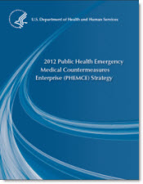
RAPID RESPONSE PLATFORM
“In spring 2009, the H1N1 virus was first identified in a Department of Defense test program in Southern California. It was genetically mapped, and a candidate antiviral drug was designed and produced within two weeks. This was a demonstration of the technologies that will be required for developing and producing medical countermeasures in the years ahead”
WMD Terrorism Research Center’s Bio-Response Report Card, Oct 2011
“The United States must have the nimble, flexible capability to produce and effectively utilize medical countermeasures in the face of any attack or threat whether known or unknown – novel or reemerging – natural or intentional. ”
HHS PHEMCE Strategy, 2012; HHS PHEMCE Review, 2010
“We have supported several successful rapid-response integration exercises that demonstrated the capability to respond to real world emerging infectious diseases and biothreats by rapidly identifying the threat, designing and producing therapeutic candidates against the threat, and then evaluating the preclinical efficacy of therapeutic candidates—all within a matter of days. ”
JPM-TMT Quarterly Newsletter, Volume 1, Issue 1, February 2012

Slide 25
PMO= Phosphorodiamidate Morpholino Oligomer RNA= Ribonucleic Acid
Base: Adenine (A), Guanine (G), Cytosine (C), Thymine (T)

Slide 26
Unprecedented developmental timeline for real world threats
3. Manufacture Candidates in Preclinical Study Quantities
Identify Target Sequences
2. Design Drug Candidates
Threat | Setting | Response | Success
Feline Calicivirus 12 Aug 2002 | Lethal outbreaks in kittens in Atlanta, GA and Eugene, OR | Prepare PMO targeting virus based on culture studies. | 47/50 treated kittens survive 3/31 untreated kittens survive LEAD: Norovirus
West Nile Virus 15 Oct 2002 | Lethal outbreak in Humbolt Penguins Milwaukee Zoo | Concept to treatment in 7 days | 3/3 treated penguins survive 1/8 untreated penguins survive IND in 2003; PhI trial conducted
Ebola Zaire 11 Feb. 2004 | Accident at USAMRIID | Concept to delivery in 7 days, Emergency IND | IND filed in 2008; PhI in progress Nature Med. 16: 991 (2010)
Pandemic Flu 5 June 2009 | TMT request for rapid response, Exercise 1. | Concept to compound in 7 days | Efficacy in mouse and ferret infection models. IND in 2010
Dengue 5 Oct 2010 | TMT request for rapid response, Exercise 2. | Upload sequence to compound in 10 days | Efficacy in mouse and ferret infection models.
Acinetobacter 27 Jan 2012 | Patient with Colistin resistant Acinetobacter | Prepare white paper for attending physician. | Efficacy in mouse model of respiratory infection.

Slide 27
Challenges and Opportunities
Though many of these potential treatments and vaccines were developed as part of BioShield after the events of 9/11/2001 and the anthrax bioterrorism event in the US, drug development has been helped and restrained by different regulatory guidance

Slide 28
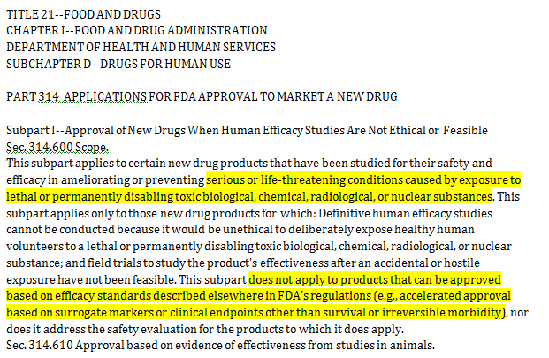
Scope of Animal Rule Provisions
Company Proprietary

Slide 29
Animal Model Considerations
Non human primates are regarded the best “disease” models
Caution must be used in interpreting laboratory data and animal models:
Laboratory = Rodents = NHP = Humans
Insufficient clinical disease data to assess comparability between human and NHP disease development
Treatment targeting host functions may be affected by subtle differences between species
Drug metabolism and excretion between species (and within species, between genders, races, body mass index, and concurrent medications) will impact identification of correct dosing
Off target or side effects will differ between humans and NHP.

Slide 30
And… all human safety is done in healthy volunteers
Includes
dose ranging to attempt to exceed the efficacious dosing curves in the infected and uninfected animals;
taking into consideration gender differences in drug distribution and elimination in both the NHP and human trials;
characterizing side effects and toxicity data as thoroughly as possible without going into the standard 3 phase drug development programs

Slide 31
Funding lessons
“in an interveiw published Sunday night, [Francis] Collins [director of the NIH], shared his belief that, if not for recent federal spending cuts, “we probably would have had a vaccine in time for this” Ebola outbreak.
NIH funding between FY 2010-14 dropped 10%
Ebola vaccine research in 2010 was $37M; in 2014, it was $18M
14 Ebola related grants shuttered due to budget constraints.
Washington Post, October 17, 2014. Source: http://www.washingtonpost.com/opinions/dana-milbank-making-ebola-a-partisan-issue/2014/10/17/53227888-55fd-11e4-892e-602188e70e9c_story.html.

Slide 32
Opportunities
Timeline for drug or vaccine development is TOO long
2004 until 2014– and all Ebola agents are no further than Phase 1 study at best
While Rapid Response exercises are useful, Rapid Response Development needs to be prioritized (e.g, decrease development from 10-12 yrs to 3-5 years)
Funding programs restricted to Governments are not sustainable; we need to explore creative Private/Public partnerships that facilitate rapid response development
Regulatory harmonization needs to occur:
Internally, in concert with the rapid response and platform mandates
Streamlined with proactively outlined steps and guidelines for emergency responses such as this event
Externally, in concert with other international regulatory bodies such as EMA and Canadian Health
Informatics communications
Not only transparently shared real time information on cases and outbreaks, but with real time quality assessment procedures for data validation
Stepped up expert assessment of epidemiologic and transmission data to rapidly identify new “hot spots” and where prevention strategies are failing
Means by which effective harmonized messaging can be obtained and used across cultural borders
SHARING of individual patient medical information across systems and borders while balanced with the respect for PHI privacy (beyond password protected “Medical Cloud”.

Slide 33
Vaccine and Platform Development
Though Ebola is an ongoing global public health threat, it is not the last of emerging infections
Swine H1N1, SARS, MERS-CoV, chikungunya, Dengue, H7N9, Enterovirus D68, multi-drug resistant TB, multi-drug resistant bacteria, HIV; Marburg- October 2014
The approach to drug and vaccine development needs to more fully embrace this “platform” approach with the ability to very rapidly develop an intervention and scale up quickly rather than “stock pile”.
This approach may need to be a global or multinational effort in order to be more effective in the next outbreak.

Slide 34
Conclusions
We are in an unprecedented time of technological successes, yet we are also in a time of unprecedented infectious disease threats.
These threats are not new.
If we are to be better managers of these events and learn from what Mother Nature can show us about globalization, and conditions that facilitate the spread of highly infectious organisms, then we need to learn to adapt and be more clearly connected across all geopolitical and geo-economic spectra.
Healthcare and economic connectivity must be embraced not as a national priority but a global priority. We must remain mission focused and get past the program, regulatory, and development restrictions that do more to hinder progress than protect intellectual property.

